Slide 1



T.V.E.T. APPLIED INNOVATION
How do Small Island Developing States develop World accredited technologies
that support the global circular economy?
PRESENTER: Ancel Bhagwandeen
Founder of
With contributions by Mr. Nigel Koorasingh
Trinidad & Tobago (CARIBBEAN)
Population: 1.4 million, English speaking
Island based energy (gas/oil) economy
80% food import dependency
High, per capita, carbon emissions
3rd International
Recycling Event
March 16, 2026
Session 5

Slide 2
THE UNIQUE CHALLENGE
Small Island Developing States face resource constraints
Import dependencies & Climate vulnerability
Linear waste systems and environmental pressures
Need for novel solutions innovation that can scale globally
Tiny individual Market size, but collectively significant.

Slide 3

THE GLOBAL SCALE
Globally Almost 40 countries are in this ‘SIDS’ catchment.
Across the Caribbean, Atlantic, Pacific, Indian Ocean & China Sea
High Biodiversity risks due to lack of economic solutions
Very sensitive to sea level rise, hurricanes, coastal erosion & pollution
Tourism drives most Island economies. But not Trinidad!!

Slide 4

Island Innovation “Laboratories”
My Role as an Island Innovation Ambassador, 2023
Island Innovation is targeted and better focused
Permits faster piloting and agile trials
Traction can influence Policy making at Gov’t level
Community adoption is simpler
THUS our small size can become a nimble advantage

Slide 5
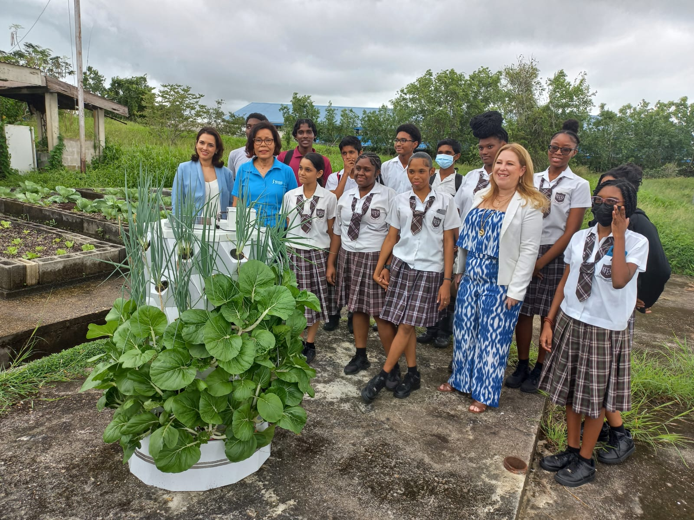

The Strategy
PPP =>TVET & INDUSTRY => CIRCULAR ECONOMY TECH => SOCIAL IMPACT
TRACTION

Slide 6
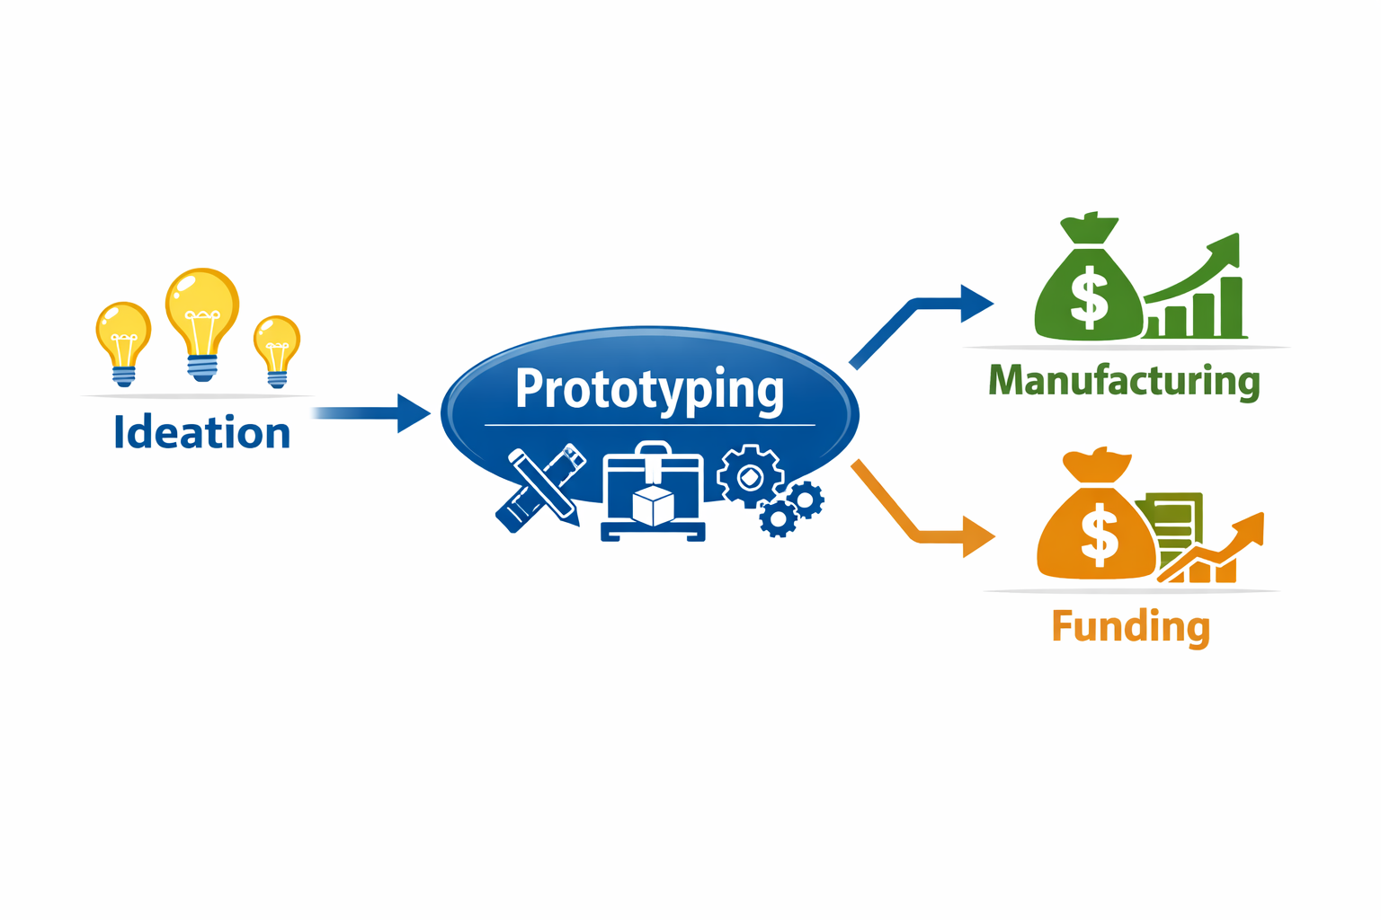
The Linkages
PPP is a Public - Private - Partnership Model
PPP is between PROTOFABTT & The MIC Institute of Technology in Trinidad
MIC is a TVET Institution with about 15 training campuses nationwide
PROTOFABTT is an agile technology developer
INDUSTRY partners = OIL & GAS, Banking, Education & Manufacturers
Thus we link Ideation/Prototyping with manufacturing partners and finance.

Slide 7
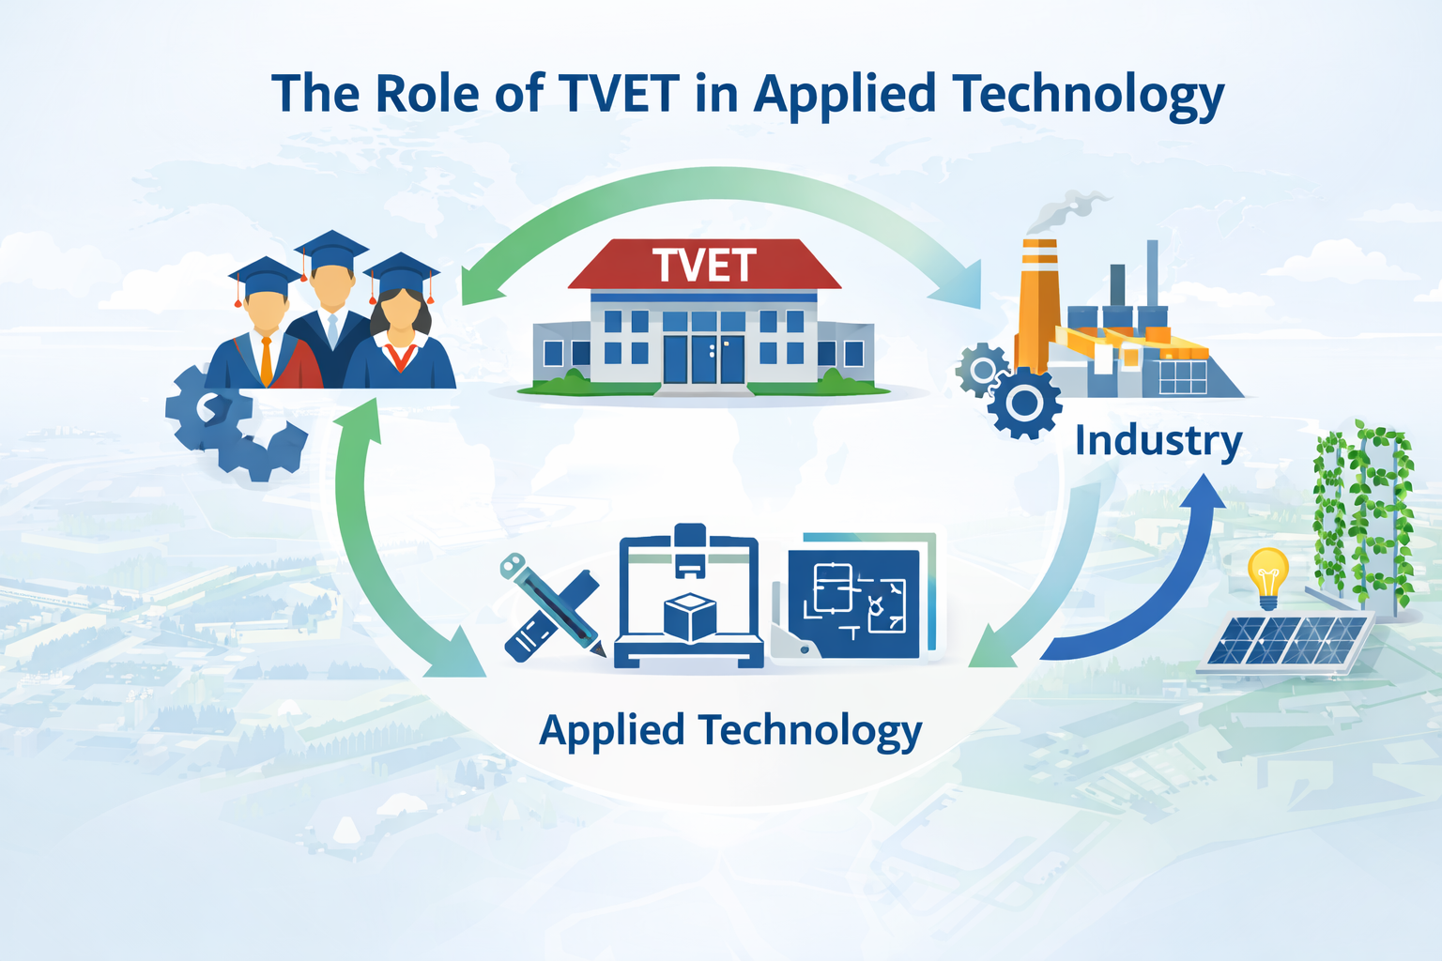
Role of TVET Institutes
Technical skills training
Hands-on fabrication
Workforce development
Applied Innovation
Technology transfer platform
A Technical and Vocational Education and Training (TVET) institution serves critical functions well beyond basic skills training; it can become a platform for:
Workforce development, applied innovation, and technology transfer.

Slide 8
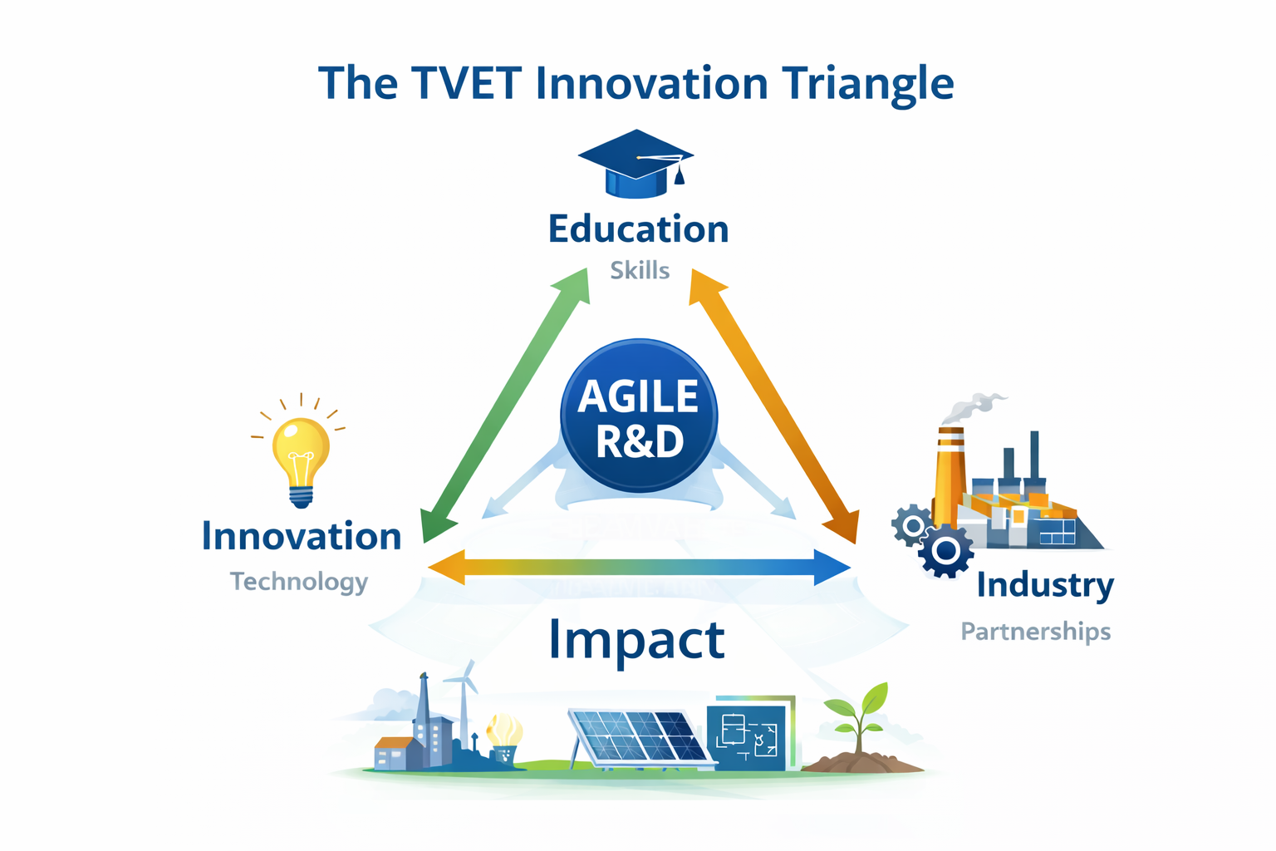
Role & FIT of Agile R&D
Agile R&D as the Central Engine
Agile R&D provides the development methodology that allows the TVET triangle to enable technology innovation and new skills suited to the needs of industry or the nation

Slide 9
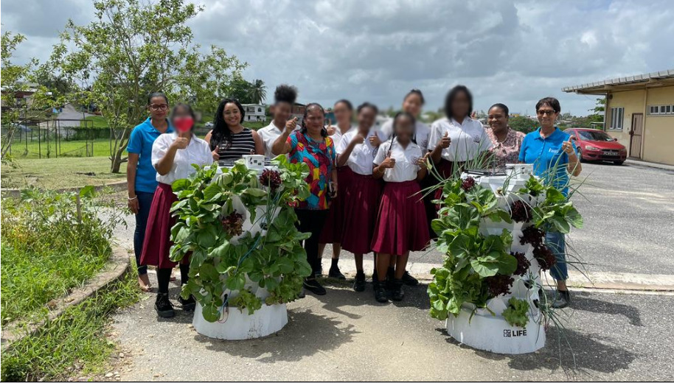




R&D & TRACTION since 2022
TEAM TRACTION
World IPO Award
2025
Hydrogen production
World IPO Award
2024,
Solar Agri-tech
Trail Blazer in Innovation
USA Accredition
2023
Commercial EXPORTS
2024
1st Place - Global
Battery Regeneration
2022
Gov’t Policy
2026

Slide 10
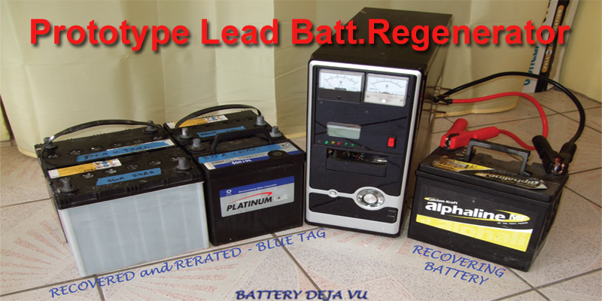
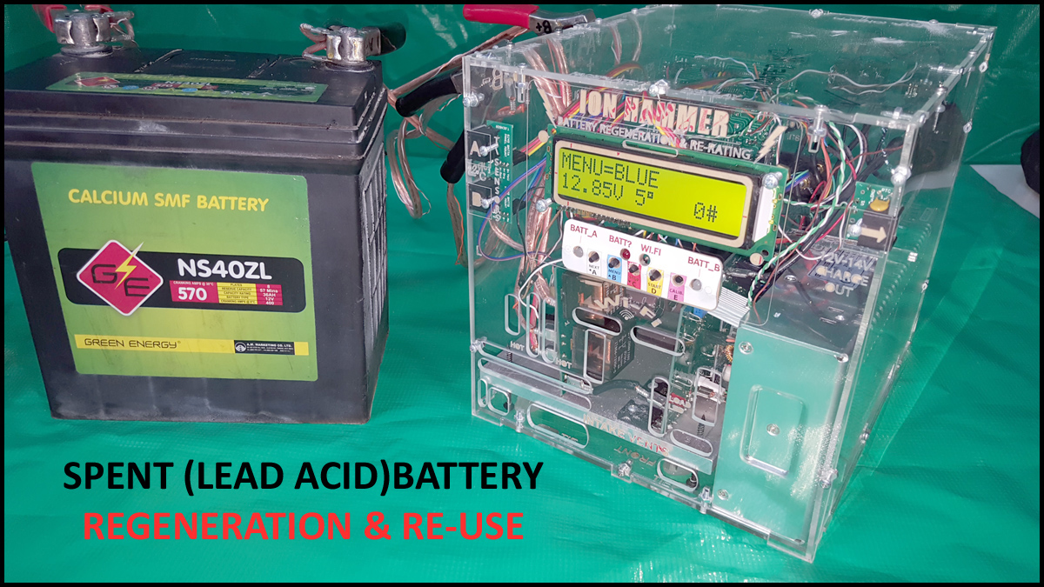
TECH #1: Sustainable Mobility
Lead Acid & HEV battery regeneration
Zero Chemical process
Internet ready: subscription revenues
Overnight battery turnaround
Handles up to 500Ah batteries
Rerates Each Battery for application use
Reduces E-WASTE
Extends battery life cycles
Suitable for Prev. maintenace of fleet batts.
1st place global, climatelaunchpad.org -2022

Slide 11
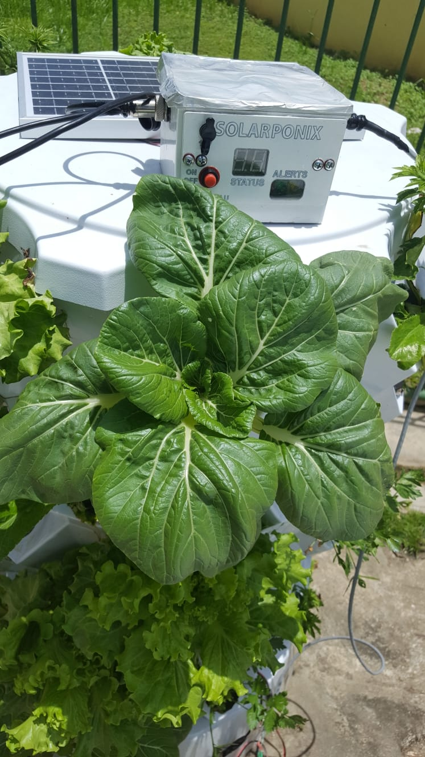

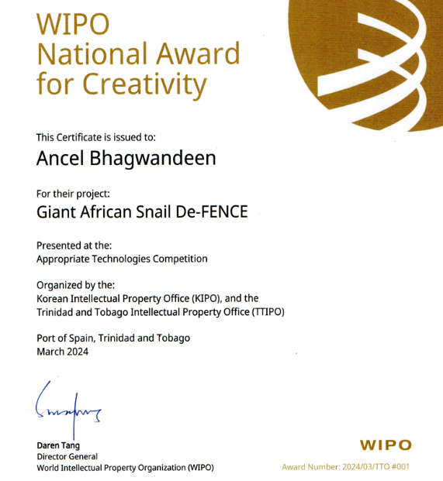
TECH #2: FOOD / SPACE / ENERGY Efficiency
96 CROPS per Sq Metre
Doorway portable
100% Solar & A.I. ready
Pest Detterent tech.
Usable by Children and less abled persons
Real Time Climate adaptive operation
Onsite crops = Reduces food transport losses/waste
Hurricane/storm avoidance

Slide 12
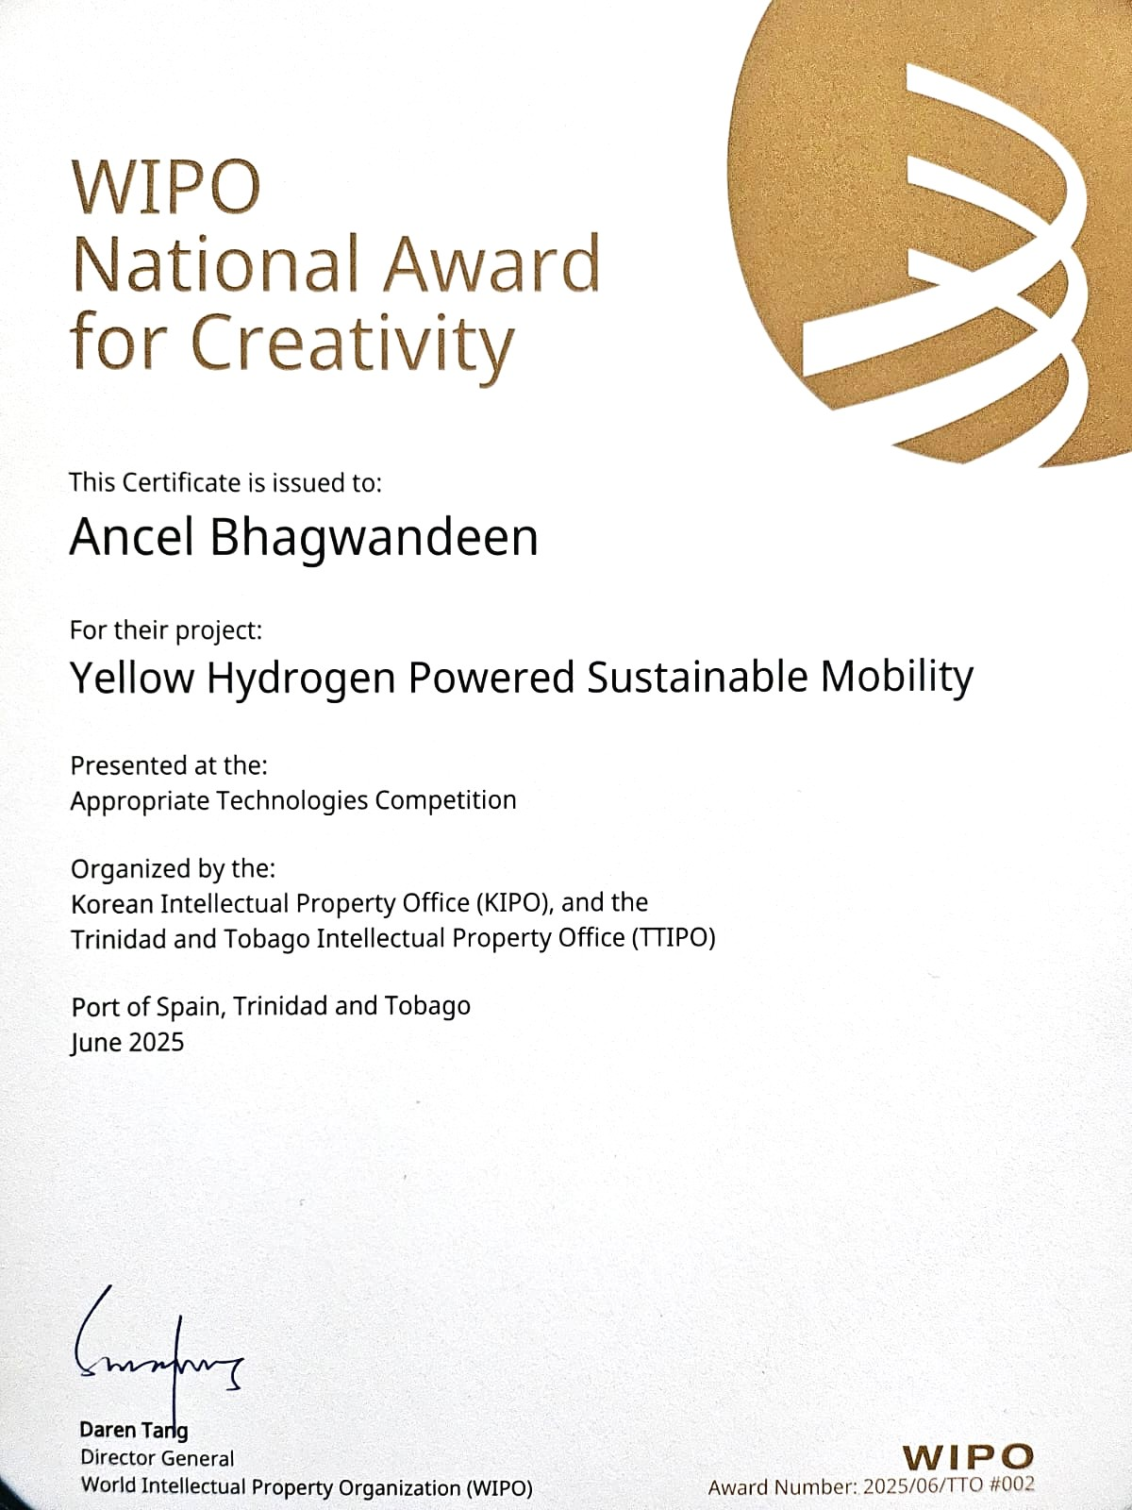
TECH #3: Hydrogen Production
Empirical Discovery (2025)
Derivative of a Battery Regeneration Invention
Not Yet Commercialized
Represents an automotive upgrade kit
Water electrolyte derives hydrogen fuel
No Hydrogen storage or transport required!
Projected 30% petrol savings in ICE vehicles
CO2 & Smog Emissions Reduction

Slide 13
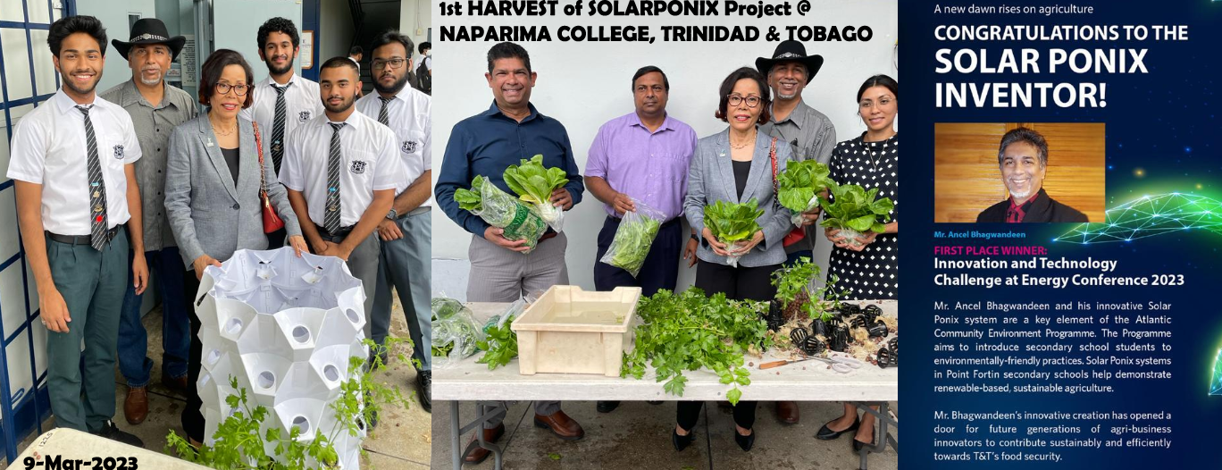
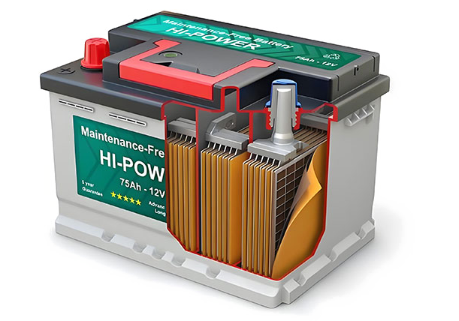
QUANTIFIED IMPACT
UNDP & WIPO Awarded
15,000 Youth, 60 Schools, benefited from improved FOOD Security skills
National Government Policy in Education to include food security in schools curricula
St Vincent & Barbados to benefit
1,000’s of Batteries Upcycled
Locations include the Caribbean, Australia & Africa
Spin off Hydrogen technology WIPO Award

Slide 14

Caribbean regional expansion
Global export markets
TVET-based innovation ecosystems
Circular economy technologies

Slide 15
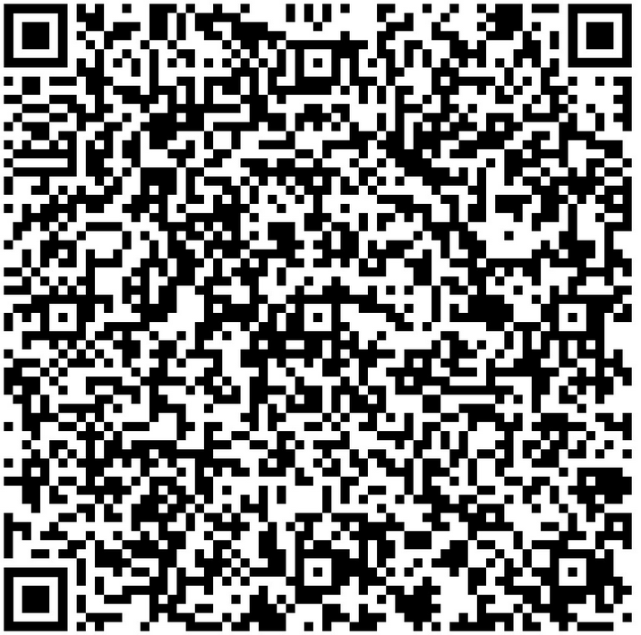
Human creativity + applied engineering + partnerships = scalable circular economy innovation.
Partners & Sponsors
QR Code : Scan Me!
protofabtt@gmail.com
MIC Institute of Technology- manufacturer
The Ideas Foundation NGO - community
Soroptimist’s Int’l. – gender/women support
The Digicel Foundation – Grants/mentoring
Atlantic LNG programme –Education/youth
Point Lisas Nitrogen Ltd – Fertilizer/Nutrition
National Gas Co.– Energy producer
MASSY GAS – Regional Outreach
UNDP(TT) – UNSDGs & scaling
ANSA McAL – distributor & marketing
JMMB – bank/finance/OP-EX
REPUBLIC BANK LTD
USA EMBASSY – Trinidad & Tobago

