Slide 1
Recycling Land and Buildings
Barry Hersh
New York University
SPS Schack Institute of Real Estate

Slide 2
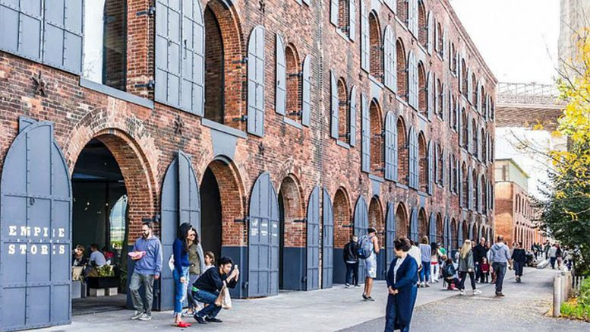
Adaptive Reuse: New Uses for Old Buildings
Adaptive reuse: the process of reusing an existing building for a purpose other than which it was originally built or designed for. Adaptive reuse is an effective tool for optimizing the performance of built assets.
Adaptive Reuse may be Renovation, and may be tied to Historic Restoration meeting SHPO requirements.
Adaptive Reuse often saves embedded energy and popular with community
Empire Stores, Dumbo Brooklyn NY

Slide 3
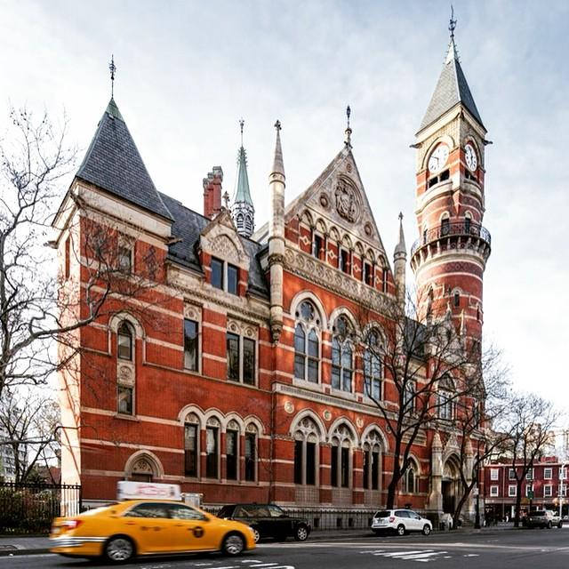
Historic Restoration of Exterior
Adaptive Reuse of Interior
Jefferson Market Library, Greenwich Ave, New York, NY
Built in 1875 as a court house, then a women’s prison, then a market and saved by local groups
Original design by F. C. Withers and Cavert Vaux, reuse design by Giorgio Cavaglieri in 1965
Seen of several famous trials and now interior spaces used for various library functions

Slide 4
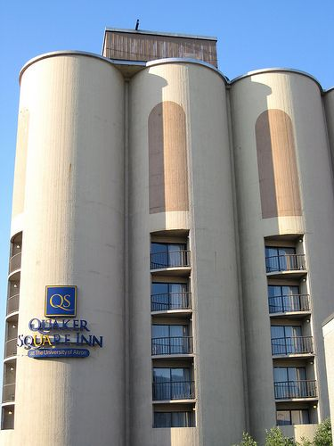
Issues in Adaptive Reuse
Can this building be efficiently reused? Will market accept new uses?
Cost of renovation, compared to new construction, especially skills for historic restoration
Will zoning permit new uses?
Are there environmental concerns, especially for use by children (lead paint, asbestos)
American Disabilities Act access requirements
Sustainability: benefits of reusing structure, energy efficiency
Concrete silos to hotel, Akron OH

Slide 5
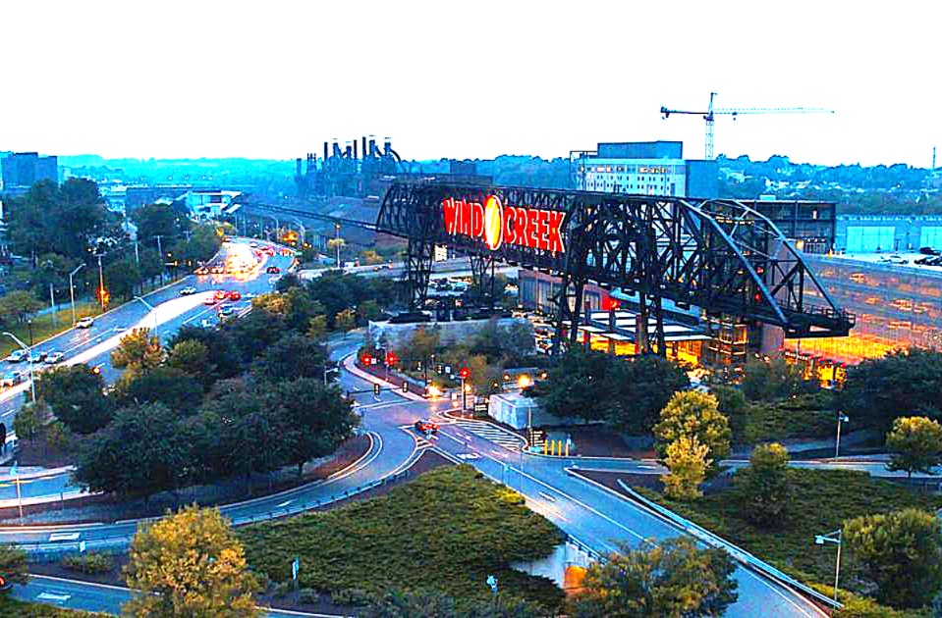
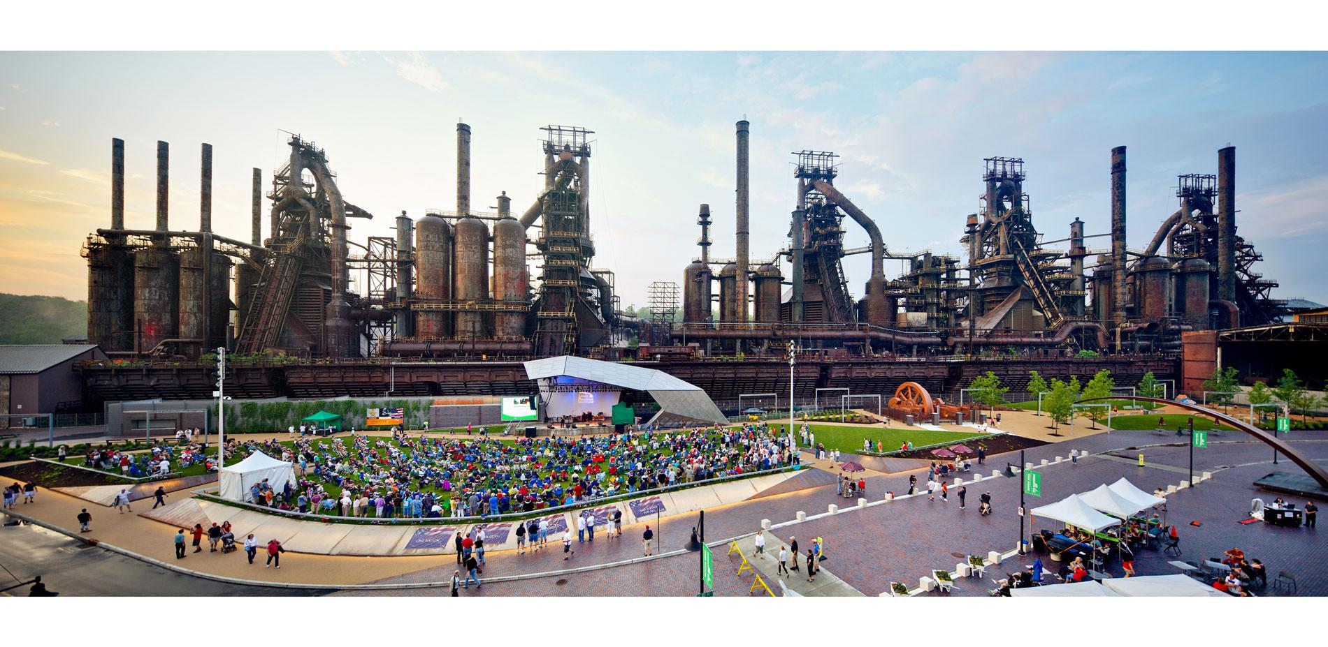
Bethlehem, PA Steel Mill to Steel Stacks Arts and Cultural Center + Casino and Hotel

Slide 6
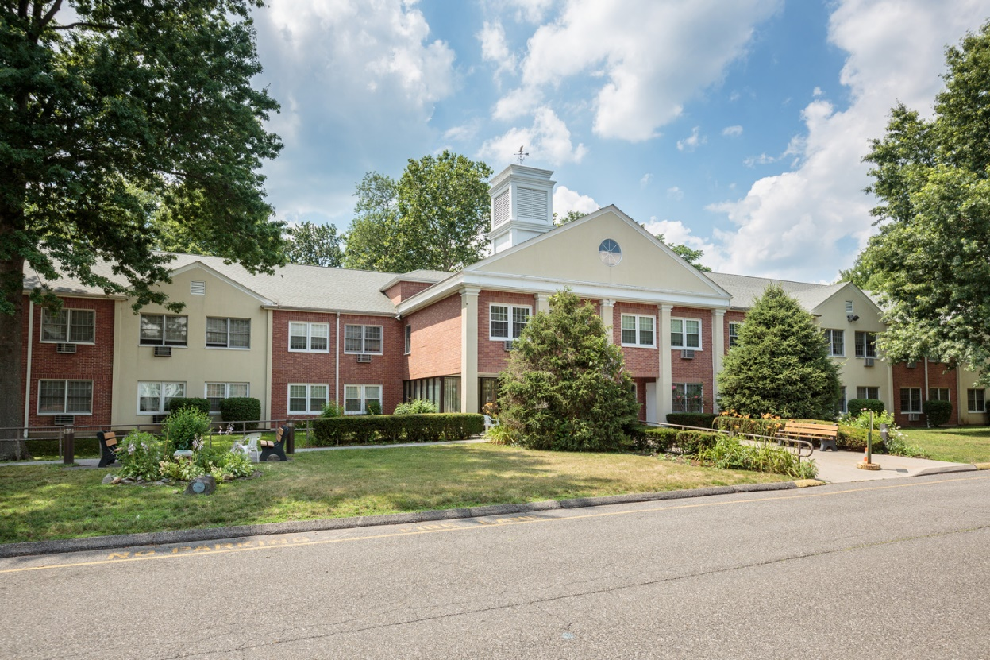
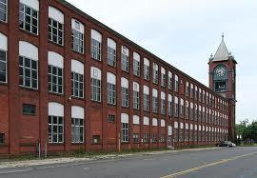
Residential Adaptive Reuse
Wormser Senior Housing, former Vine Street School, Stamford CT
Ludlow Mills Apartments, MA

Slide 7
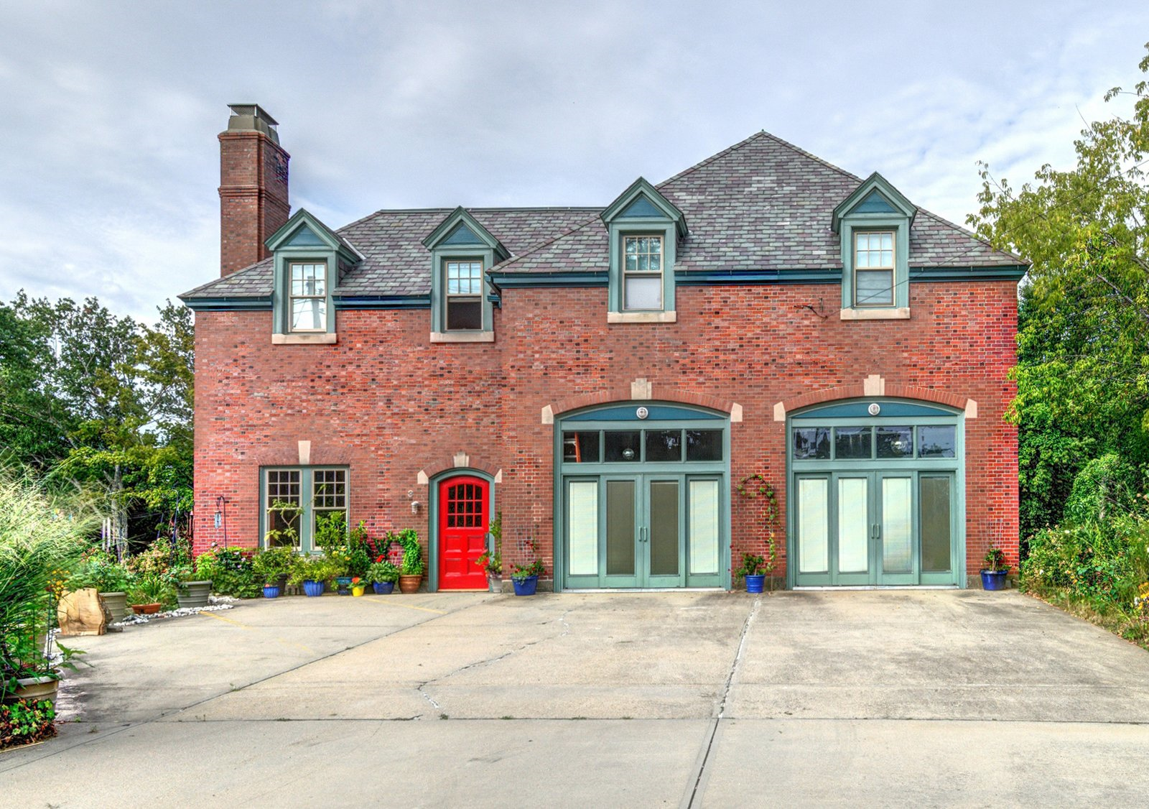
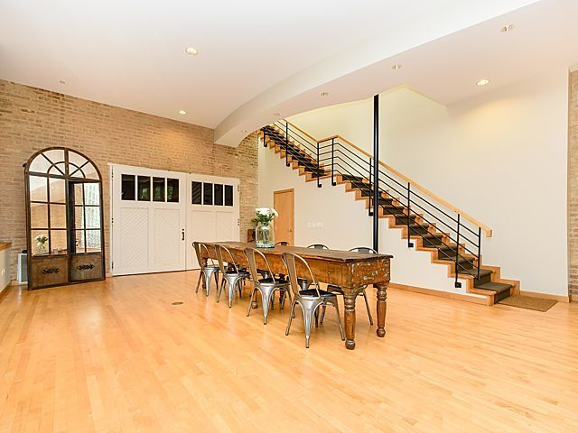
Firehouse to Residence with the Pole

Slide 8
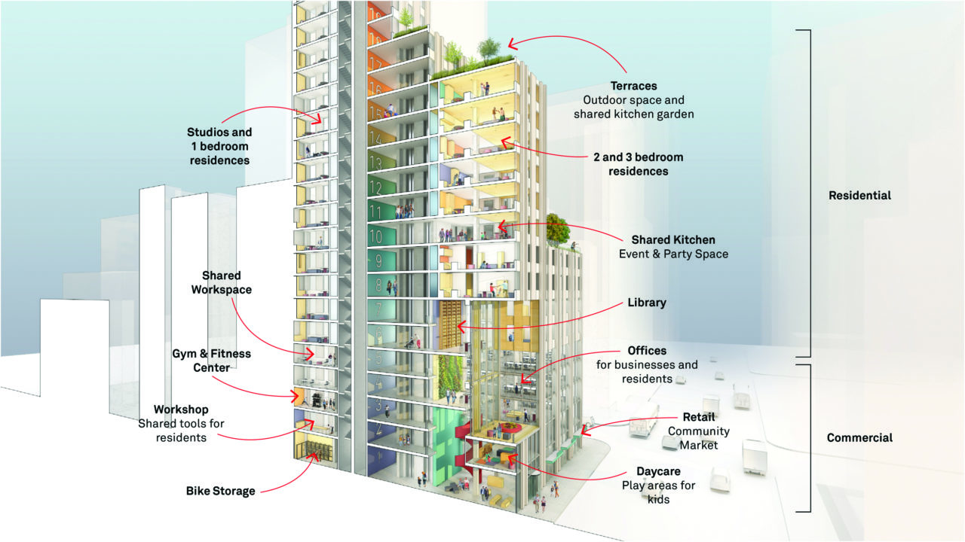
Office to Residential
Real Estate Flexibility, some buildings’ configuration more adaptable than others.
Floor plates, windows, plumbing (from 4 bathrooms per floor to 50)
Access, efficiency, zoning
Façade adaptability, Light and Air
Broad Exchange, Metroloft, Silverstein, Rudin, many others

Slide 9
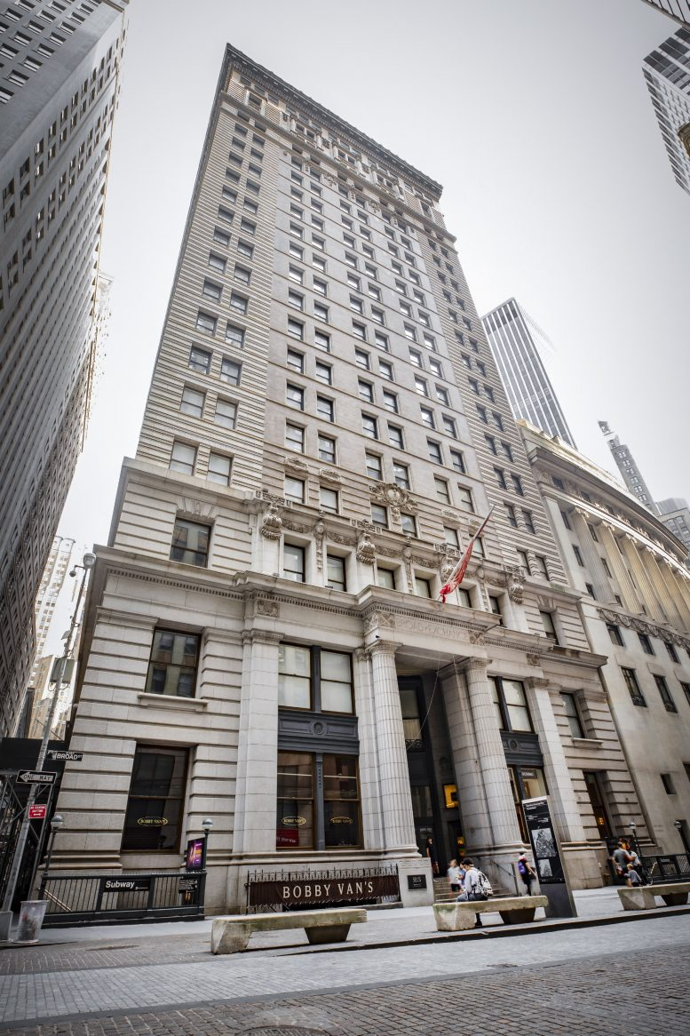
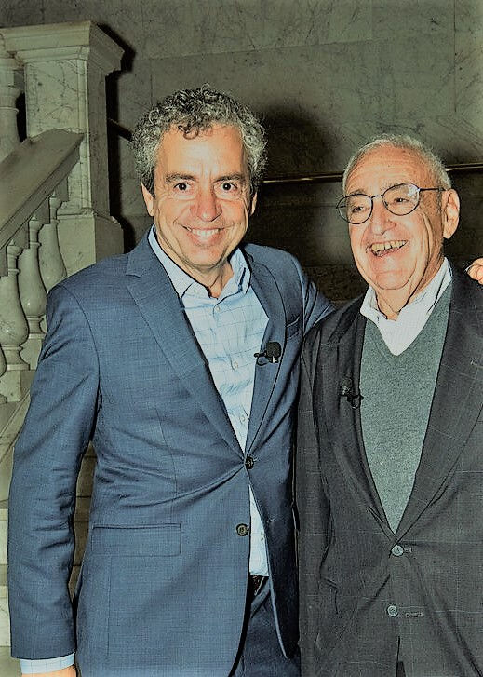
Office to Residential Case Study
Broad Exchange Building
Russell Shorto Barry Hersh t Broad Exchange talk, Oct 2023
1902 Historic Landmark
Across from NY Stock Exchange
22 stories, 325,000 SF,
LCOR 360 condos
Specific market
Lower Manhattan Financial District Residential Conversion
Russelll

Slide 10
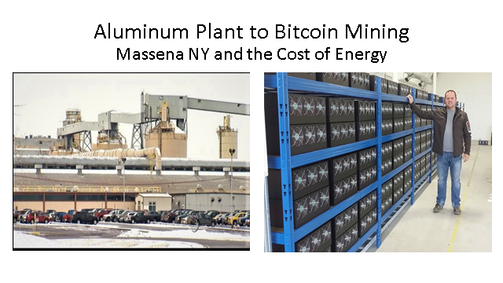

Slide 11
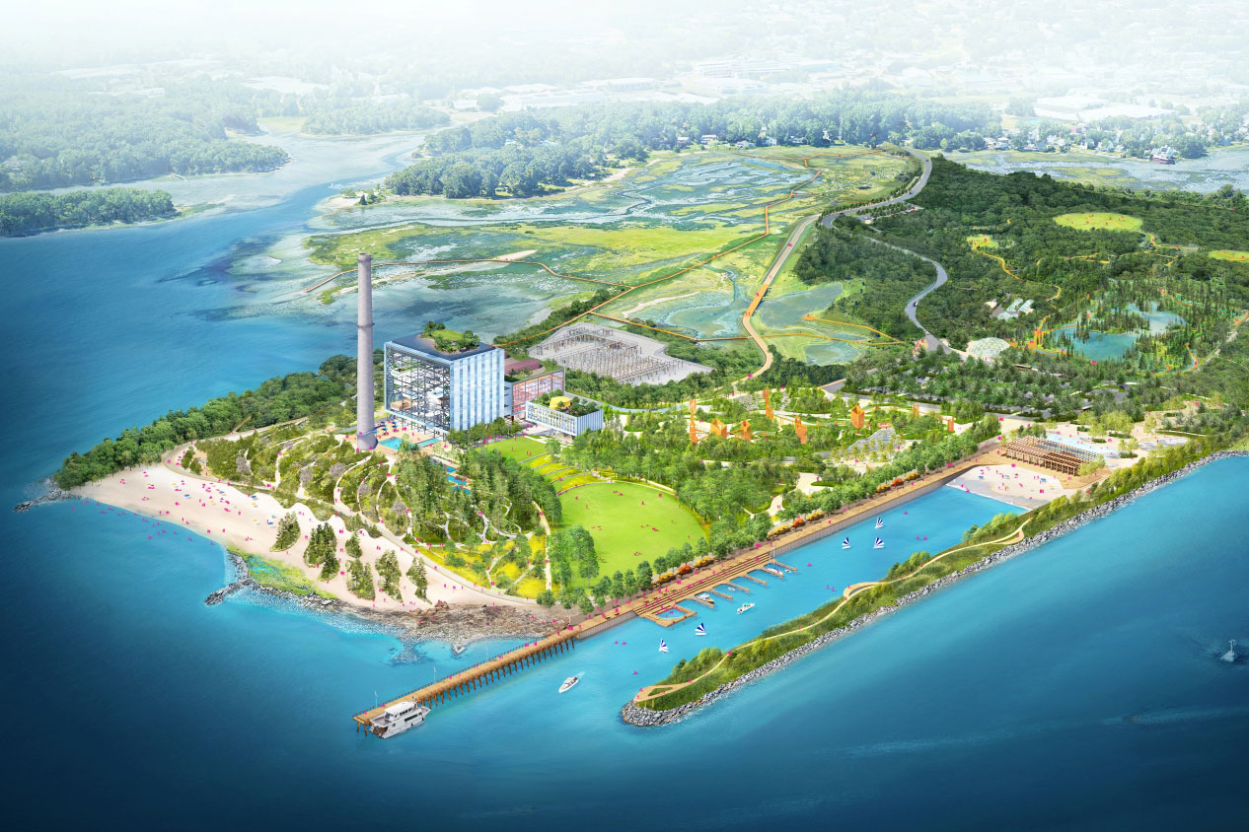
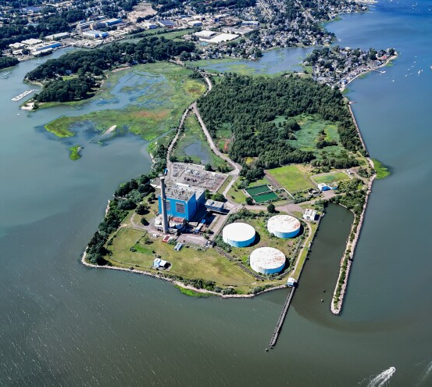
Manresa Island, Norwalk, CT
Marsh land, Agriculture, 1800s
Religious Retreat 1900s
Power Plant built in 1953, closed in 2013
Contracted to Argent Properties 2023
Mchord family pays for $40MM for park 2024
Park design by Scape and BIG

