Slide 1
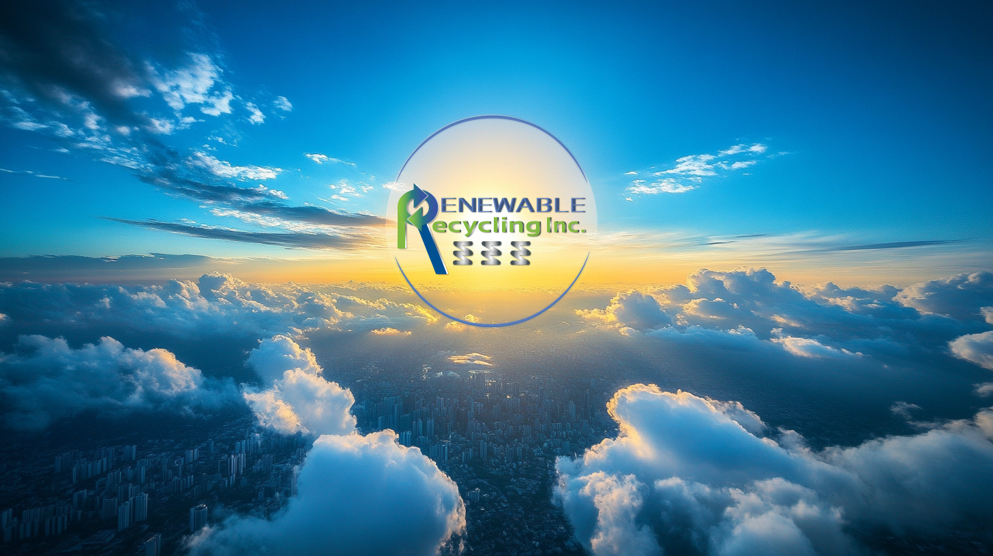
From Waste To Product
Materials Collection & Recovery
Toward A
Circular Economy
Session 4 : ‘Turning Recovered Materials
Into Viable Product
Monday, MArch 16, 2026
Notes:
“Hello everyone. I’m Christine from Renewable Recycling, Inc, and today I’ll share how our unique approach to mattress recycling is transforming waste into opportunity — creating a cleaner, more sustainable future for our communities.”

Slide 2

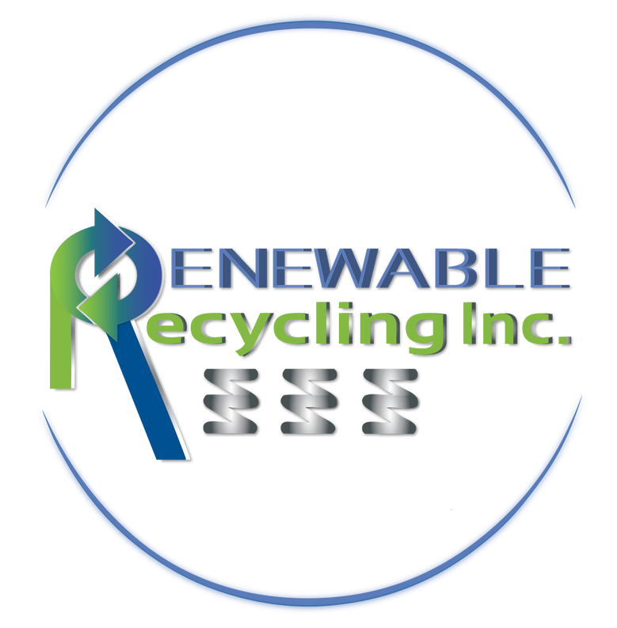
Renewable Recycling, Inc. (RRI)
Who We Are - (VERIFIED)
Our Goals
  100% Woman-Owned
  NYS DEC Materials Recovery & Recycling Facility
  Est. October 2014
  Verified Carbon Reduction Programs
  Verified End Market Insulation Product
President: NRC Board of Directors
ANJR & NYSAR3
  Minimize Carbon Footprint
  Contribute toward a Circular Economy
  Preserve Natural Resources
Notes:
“RRI is dedicated to closing the loop on mattress waste. We combine innovation, technology, and collaboration to make recycling efficient and scalable.”
Renewable Recycling Inc is a woman-owned, DEC-Registered Recycling Facility
RRI has pioneered an effective system that processes difficult to recycle items, including mattresses, carpeting, ceiling tiles, linens & clothing - turning waste into new resources.
RRI diverts thousands of tons of bulky waste from landfills each year and provides critical tonnage diversion reporting.
We turn recycled materials into end products, with a spotlight on its dense pack/blown-in insulation products.
It all goes back to our original mission - Saving the Earth One Mattress At A Time.

Slide 3
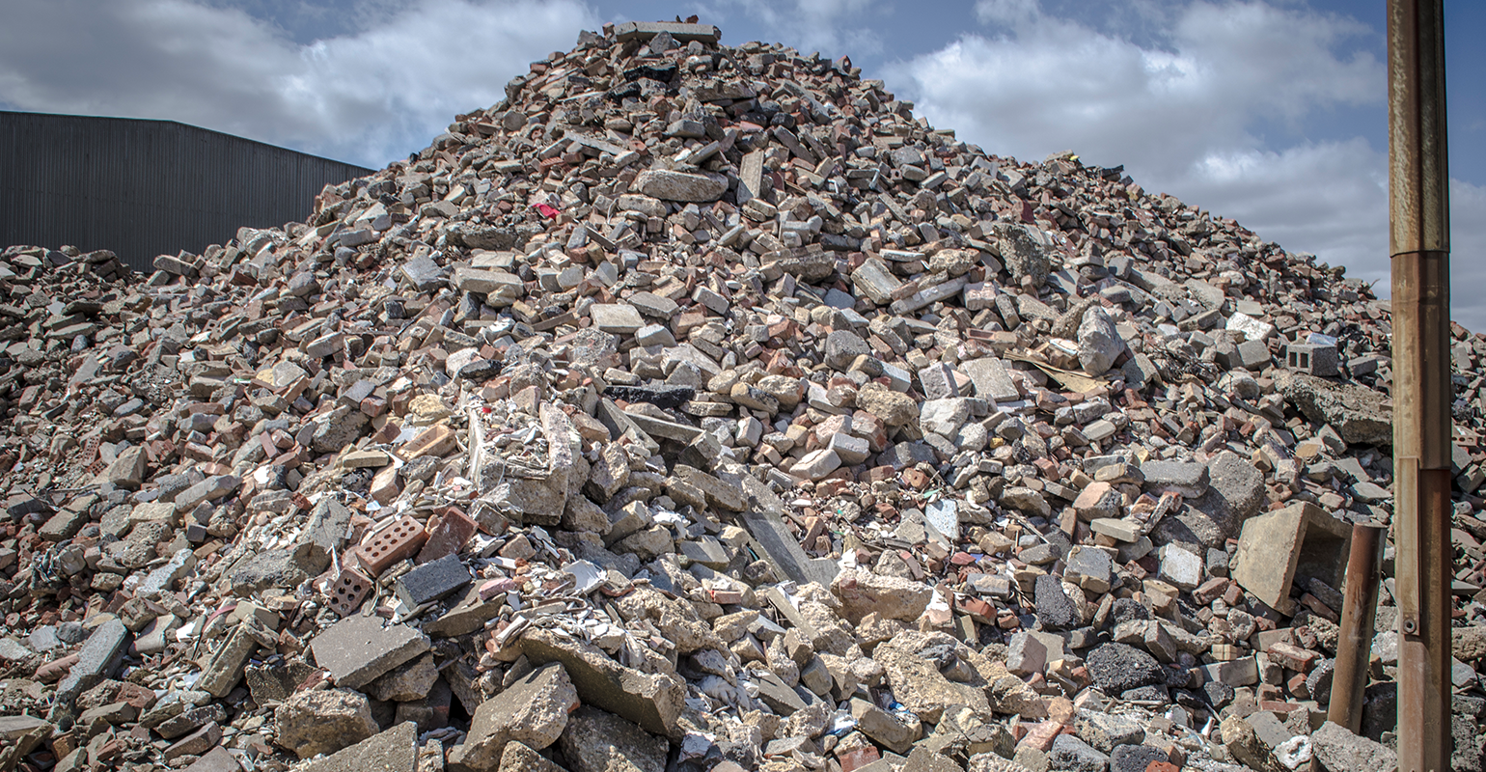
Impact of Construction Waste on our Environment
  Erosion of Natural Resources
  Greenhouse Gas Emissions
  Leaking Landfill Liners
  Limited Landfill Space
  Groundwater Contamination
Notes:
“Mattresses are not only bulky and hard to handle, they also contribute significantly to landfill volume and environmental degradation. Communities are increasingly looking for smarter, scalable solutions.”
Toxic Chemicals: Mattresses contain flame retardants, polyurethane foam, and volatile organic compounds (VOCs).
Heavy Metals: The steel springs inside mattresses rust, releasing heavy metals into the environment.
Contaminating Liquid: Rainwater and snow seep through, creating a potent and toxic liquid known as leachate.
Leaking Liners: The U.S. Environmental Protection Agency (EPA) acknowledges that landfill liners will eventually fail leak, ultimately contaminating the surrounding ecosystem.
Groundwater Contamination: Leachate is highly concentrated & poses a risk to drinking water and wildlife!

Slide 4
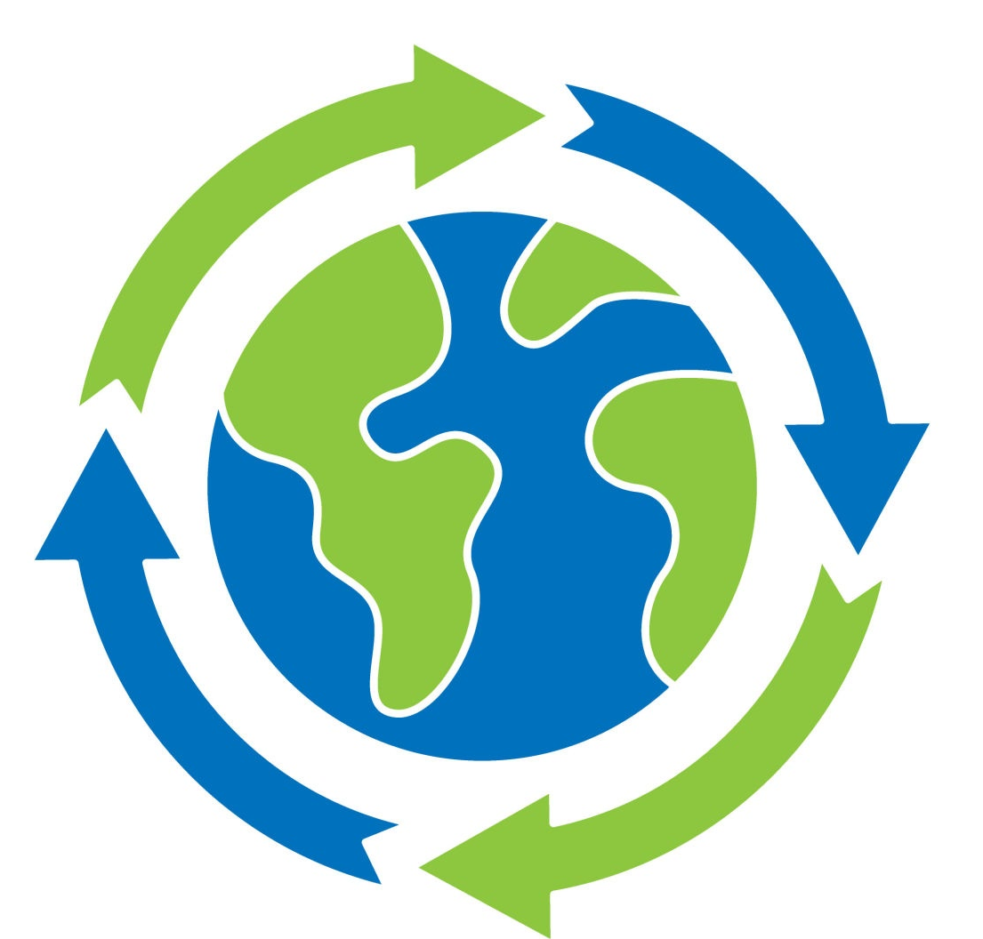
RRI’s Solution to a Circular Economy
  RRI transforms recycled materials into proprietary end products
  Each material stream — foam, metal, and textiles — is repurposed for renewed use
  This process reduces virgin material demand and closes the resource loop
  Demonstrates how circular design can be both sustainable and profitable.
Notes:
“This circular approach ensures every mattress has a second life, reducing environmental impact and supporting sustainability goals.”
RRI Processes 100% of the Materials we take in.’
The Materials Are Blended Together Through A Unique System.
RRI’s Proprietary IP OF All Natural Ingredients Are Added In For Maximum Fire Retardancy & Insect Repellency.

Slide 5


Local Municipalities: launch of bulky waste recycling programs
Building Deconstruction:
redirects significant volume of waste
Partnerships that Amplify Impact
Corporate Partners:
drive sustainable operations & awareness
Notes:
Partnerships enable us to scale impact quickly. From city programs to corporate collaborations, our partners are essential in creating real change.”
RRI’s Diverse Partnerships Cover A Gamut of Diverse Industries.
Each Has A Common Goal: Handling Municipal Solid Waste and Finding Responsible Means of Handling & Disposal
Municipalities
Hotels
Waste Haulers/Transfer Stations
Building Owners/Property Management Companies: Public & Private
Design & Build: Architects, Demolition Teams, Building Developers
Mattress & Furniture Companies/Wholesale & Retail
Universities/Military Campuses

Slide 6
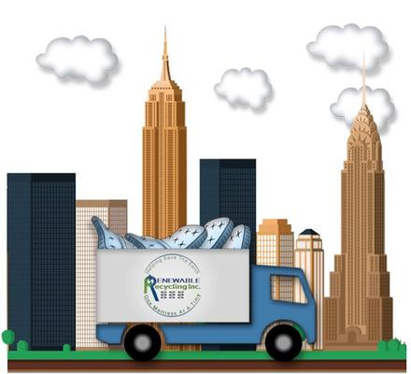
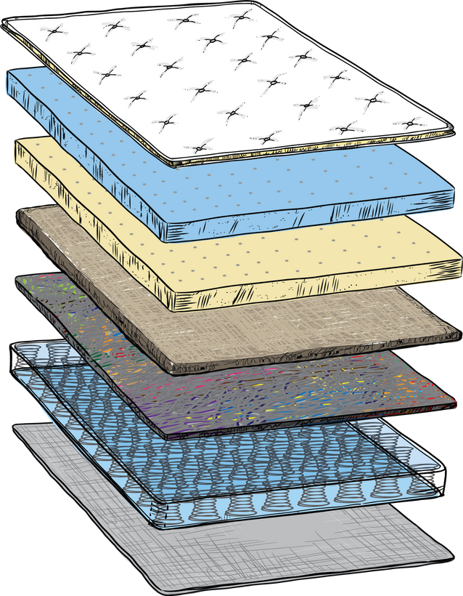

RRI’s Unique, Circular Process
Bulky Waste Materials Are Collected For Processing
Critical Landfill Tonnage Diversion Reporting Provided
EFFICIENT COLLECTION & REPORTING
*Automated machines shred down bulky materials in seconds
IN-HOUSE RECYCLING PROGRAM &
END MARKET PRODUCT
Up to 95% of materials are repurposed into a proprietary, Federally Verified
Dense Pack/Blown In
Insulation Product
CARBON FOOTPRINT REDUCTION & CIRCULAR ECONOMY
-REPORTING!! NYCHA!!!
Significant Contribution Toward A Circular Economy & Proven Carbon Footprint Reduction Program
Notes:
“Our proprietary automated systems allow us to process mattresses faster than ever before, increasing volume while maintaining precision and quality.”
EXPANDING ON TEXTILE MATERIALS FROM CARPET, FLOORING, ACOUSTIC CEILING TILES, CARDBOARD, LINENS FOR A CIRCULAR SOLUTION!

Slide 7
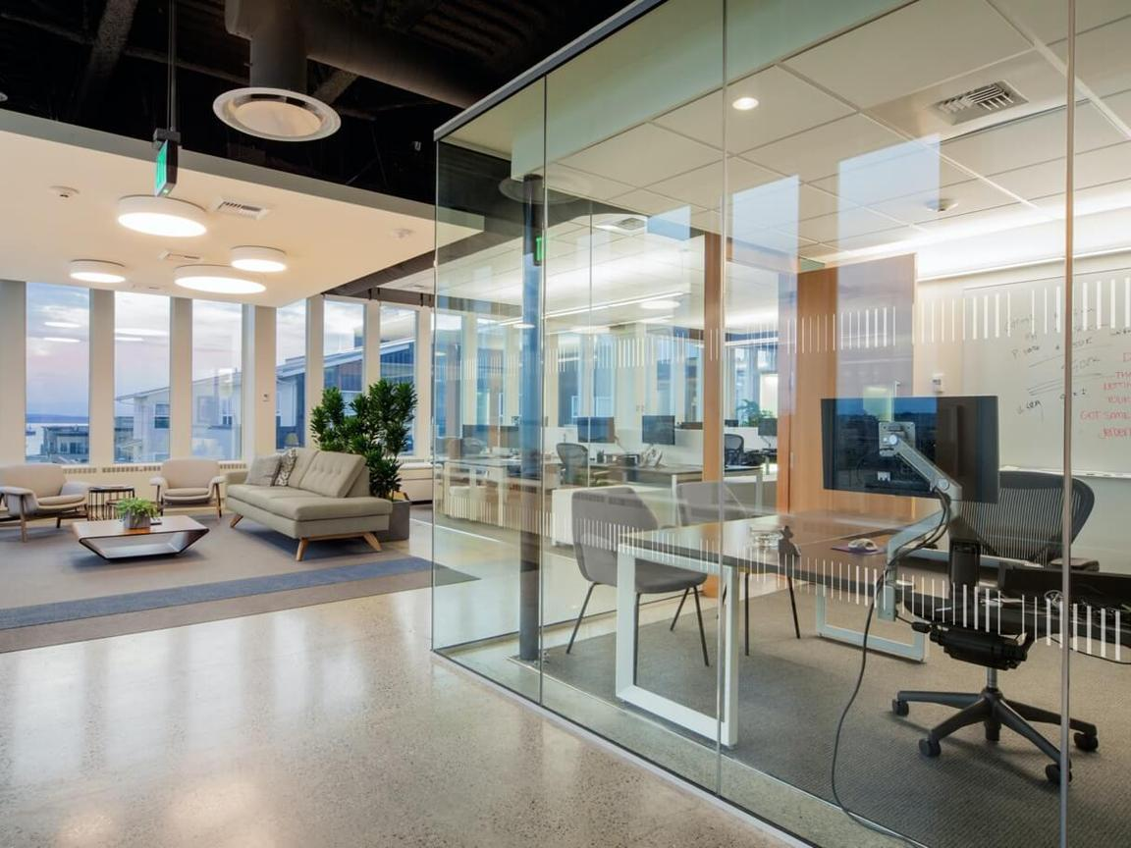
A CLOSER LOOK
AT LANDFILL DECOMPOSITION RATES OF
MATERIALS IN BUILDINGS
Furniture with Foam Materials
Natural Materials: 25+ yrs
Synthetic Materials: 200+ yrs
CEILING TILES
Gypsum, Mineral Fiber & Cellulose: 10+ years
Fiberglass: 1,000+ years
GLASS
5,000+ YEARS
E-Waste
100-2,000 YRS
( different components degrade at varying levels )
CARPET & PADDING
Natural Materials: 15+ yrs
Synthetic Materials: 400+ yrs
VINYL TILE
400 + years
METAL
200- 1,000 years

Slide 8
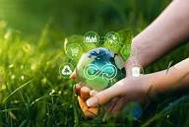
The Role of Technology
In Amplifying
Sustainability Programs
  Stringent State & Federal Authority regulations call for proper handling, processing & reporting on materials processed.
Automated Machinery plays a vital role in:
Higher recovery & recycling rates
Higher accuracy of landfill diversion reporting of materials recovered = ROI for Clients!
Higher rate of recovered materials toward end market product = reduced carbon footprint
Advanced Data Testing with Quicker Results
= A Proven Circular Solution
Notes:
“This circular approach ensures every mattress has a second life, reducing environmental impact and supporting sustainability goals.”
RRI Processes 100% of the Materials we take in.’
The Materials Are Blended Together Through A Unique System.
RRI’s Proprietary IP OF All Natural Ingredients Are Added In For Maximum Fire Retardancy & Insect Repellency.

Slide 9
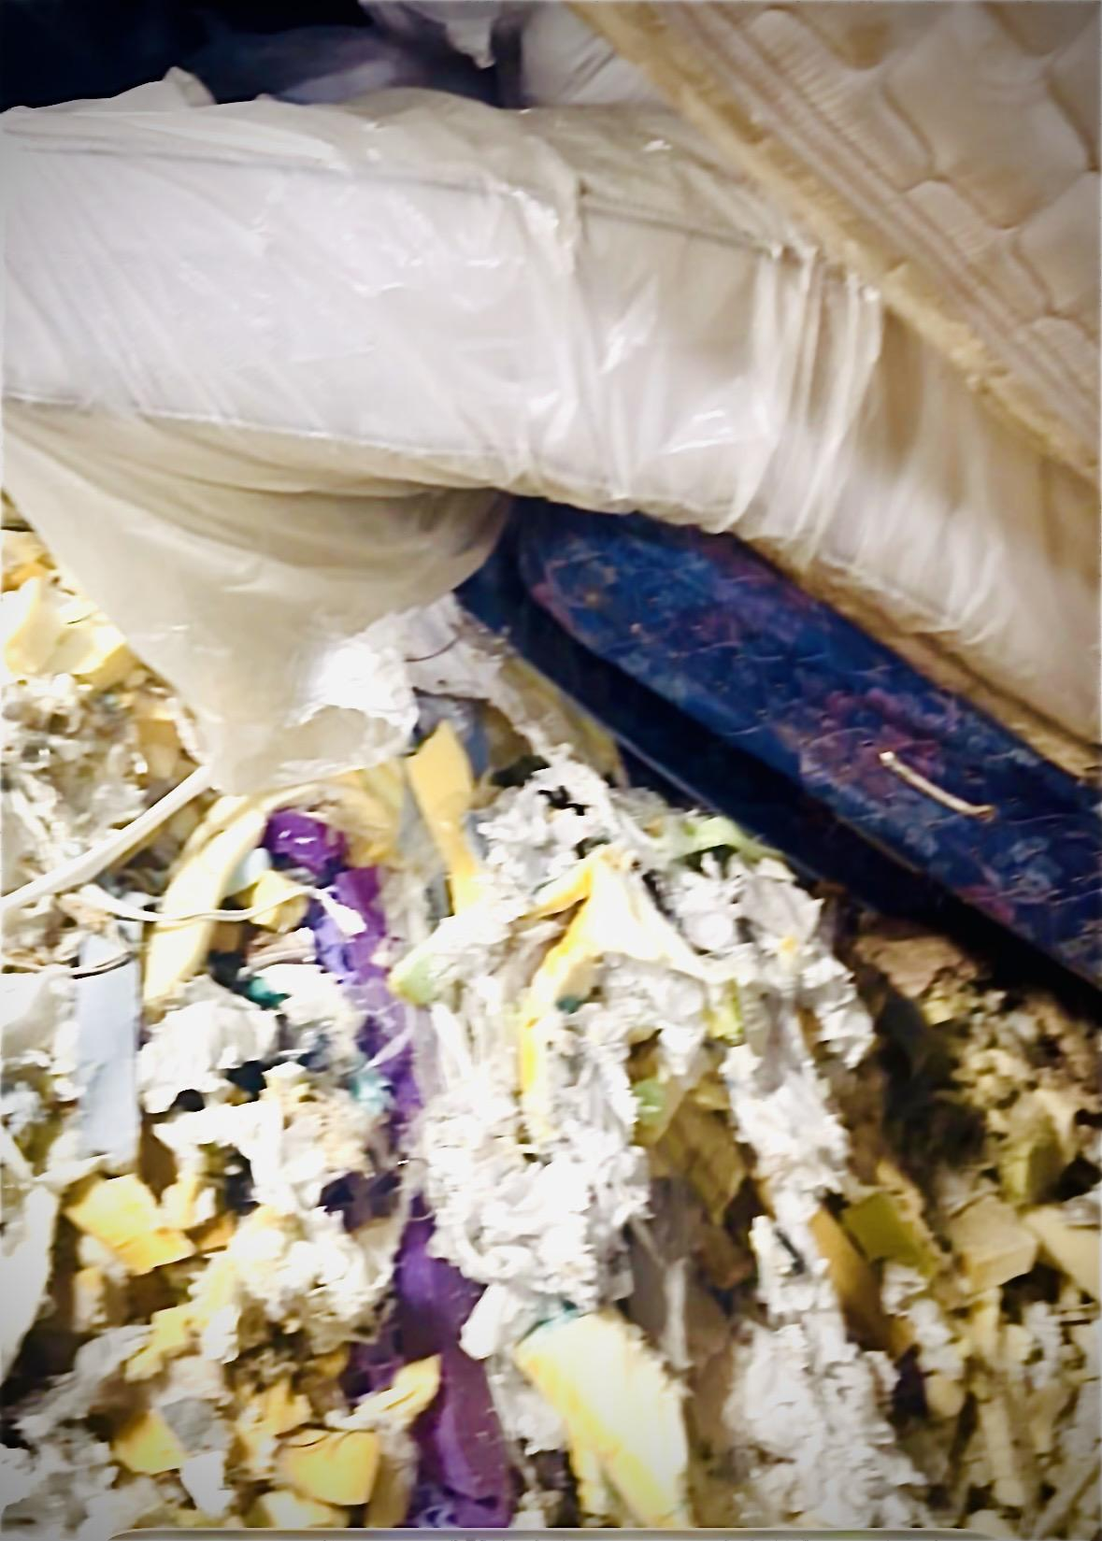
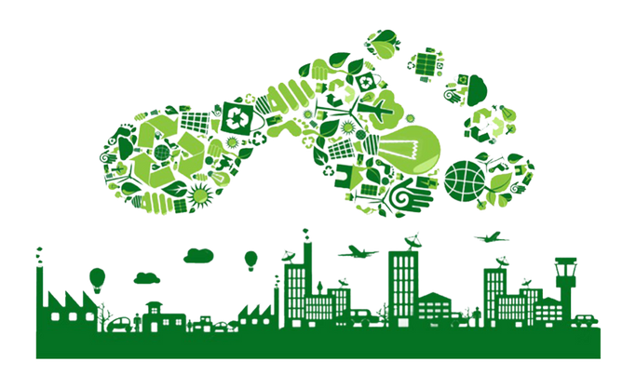
Automated
Recovery, Recycling & Manufacturing Process
Recyclable Items RRI Recovers
  Mattresses & Box Springs
  Carpet Carpet Tile & Padding
  Cardboard
  Acoustic Ceiling Tiles
  Vinyl Tile
  Gypsum/ Drywall
  Linens
  Clothing/Uniforms
  Paper-based Products
Notes:
“Thank you for your time. Together, we can transform mattress waste into opportunity, building cleaner communities for future generations.”

Slide 10
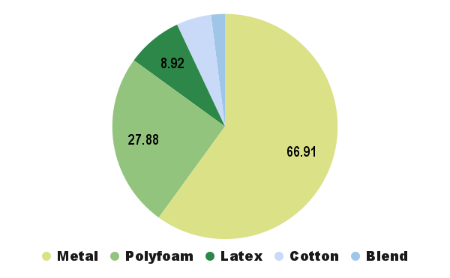
RRI’s Measurable Success
  Thousands of TONS of bulky waste diverted from landfills annually
  CO₂ emissions reduced through recycling
190 MATTRESSES / AVG
10 tons of Textile Materials Recycled
= 1 Carbon Tonne Reduced
  Sample Project:
Highgate Hotel Group - Q1 2025
Collection, Processing & Reporting of Materials Recovered & Repurposed
    111.51 tons of materials
diverted from landfills
      66.9 tons of metal
      27.8 tons of polyfoam
      8.92 tons of latex
      5.58 tons of cotton
      2.23 tons of blended materials
Notes:
“Results speak for themselves — our programs have a measurable impact on both communities and the environment.”

Slide 11
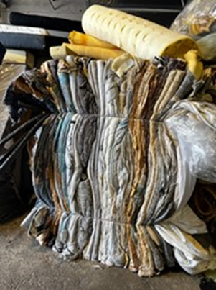
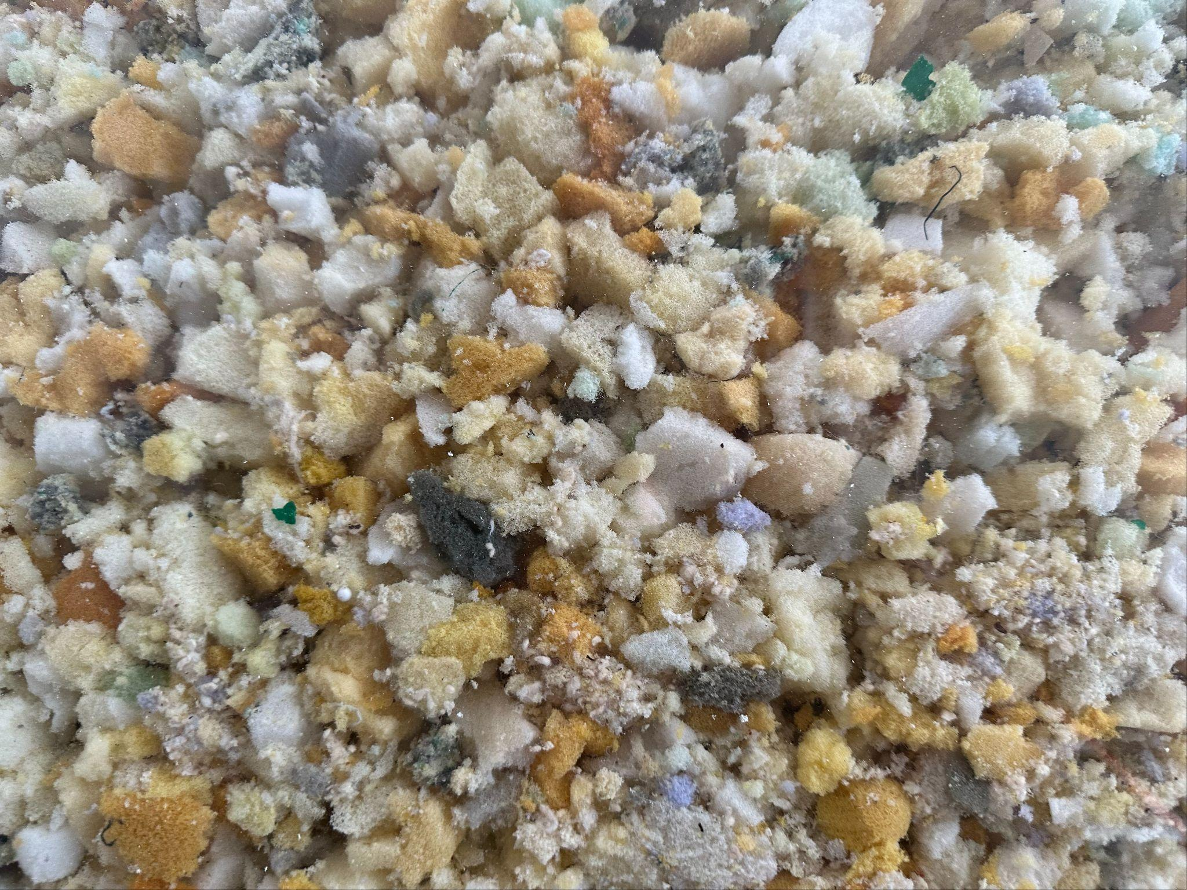
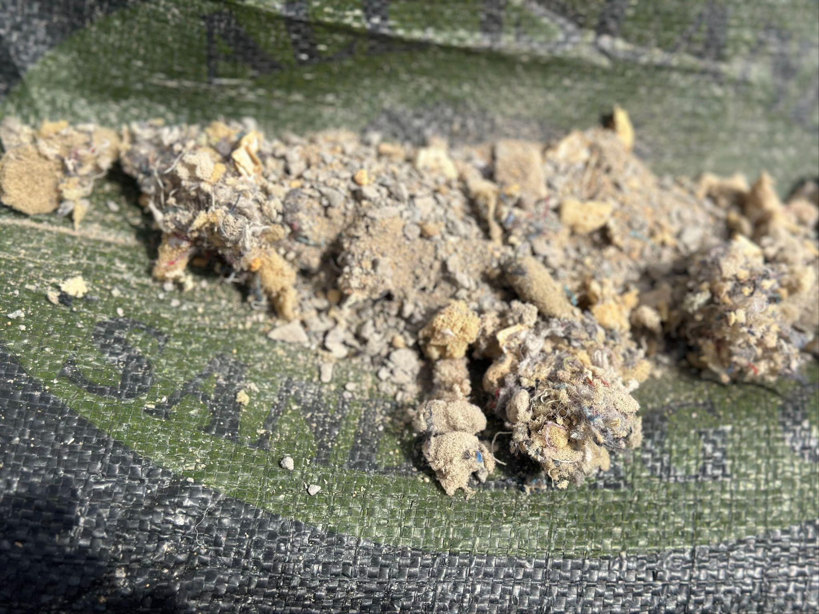
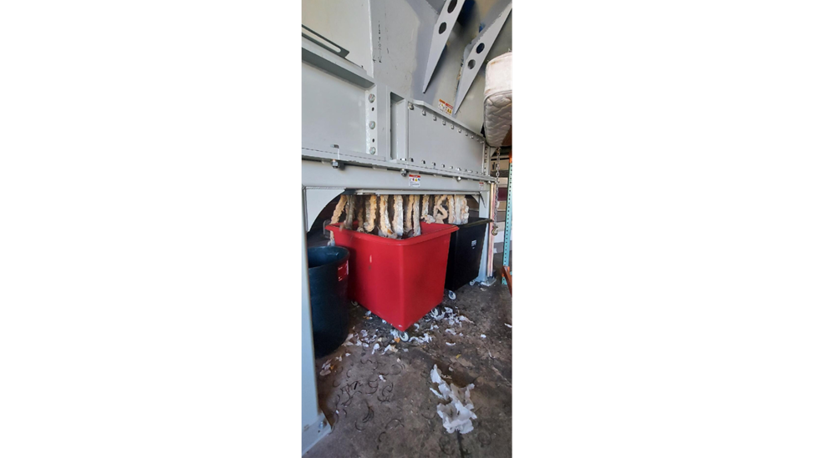
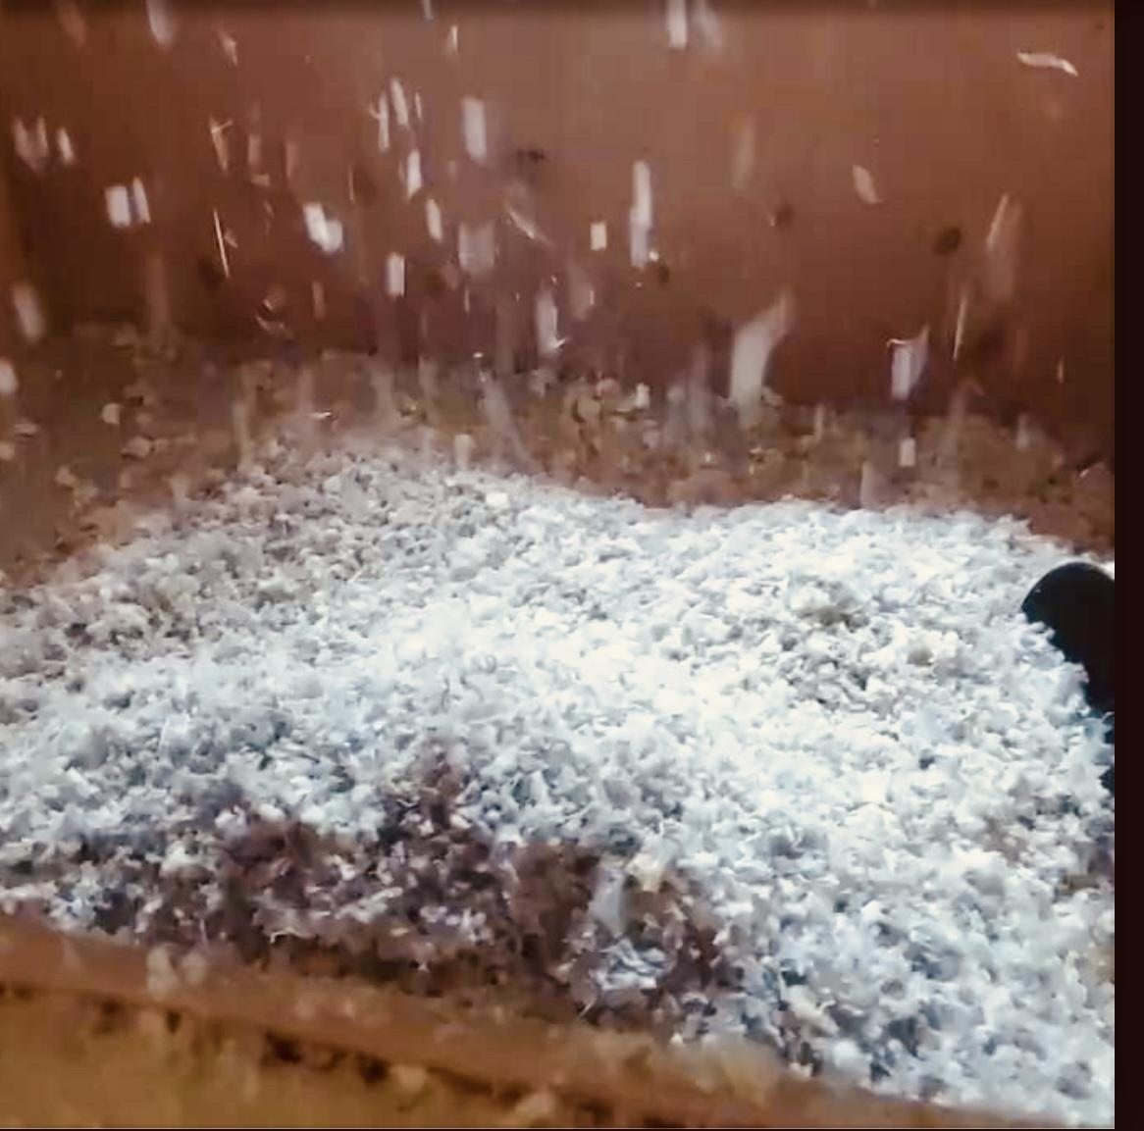
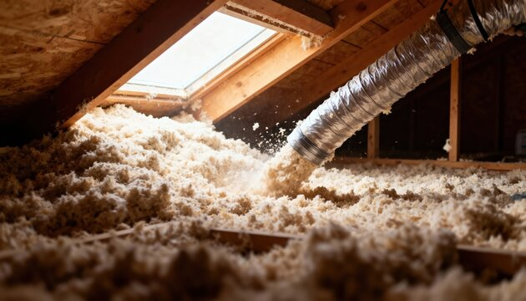
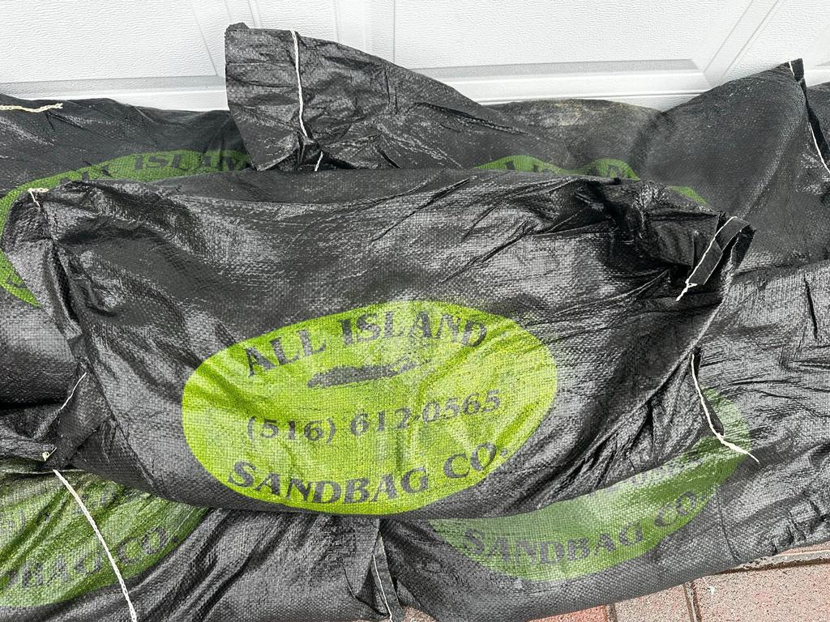
RRI’s End Products from
Recycled Materials
‘Eco Fibertek
Blown In Insulation
‘All Island Sandbag Co.’
VERIFIED FEDERAL & STATE LAB TESTING . 95% OF RECYCLED MATERIALS
Notes:
Verified Federal & State ELAP LAb testing for Corrosiveness, Fire & Insect Retardency, Sound Proofing, PFAS, VOCs MOCs
95%: mixed textiles + IP of Natural
Fire & Insect Repellency
Meets And/OR Exceeds ATSM
Industry Standards!

Slide 12
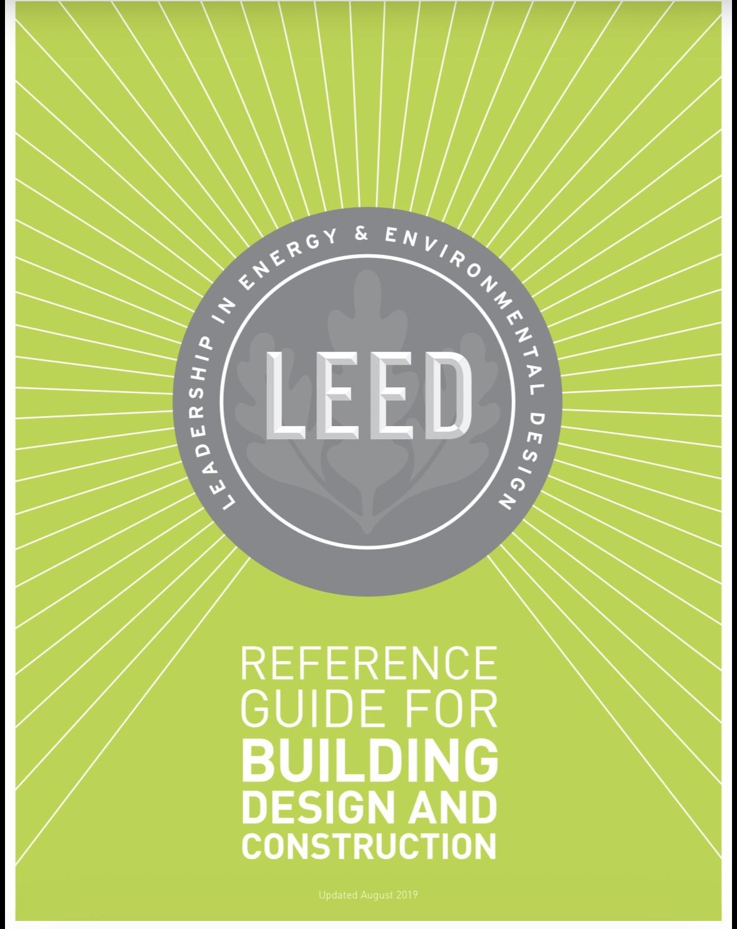
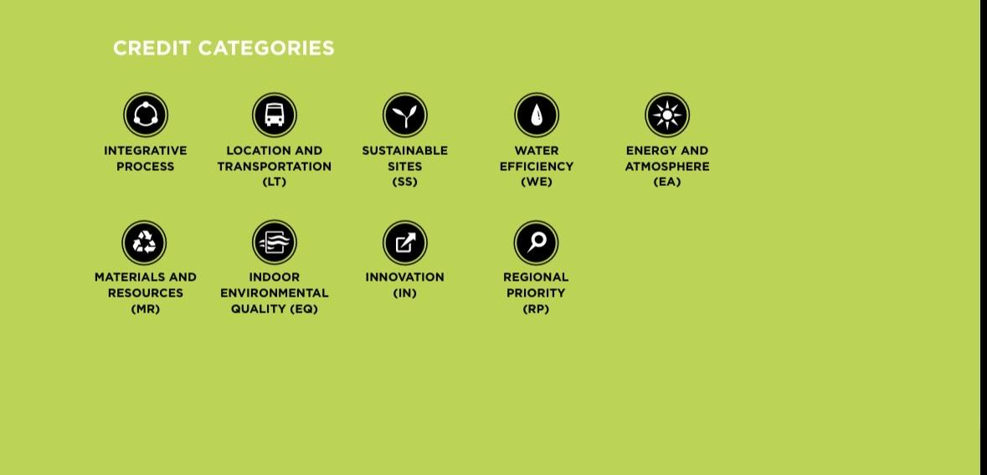
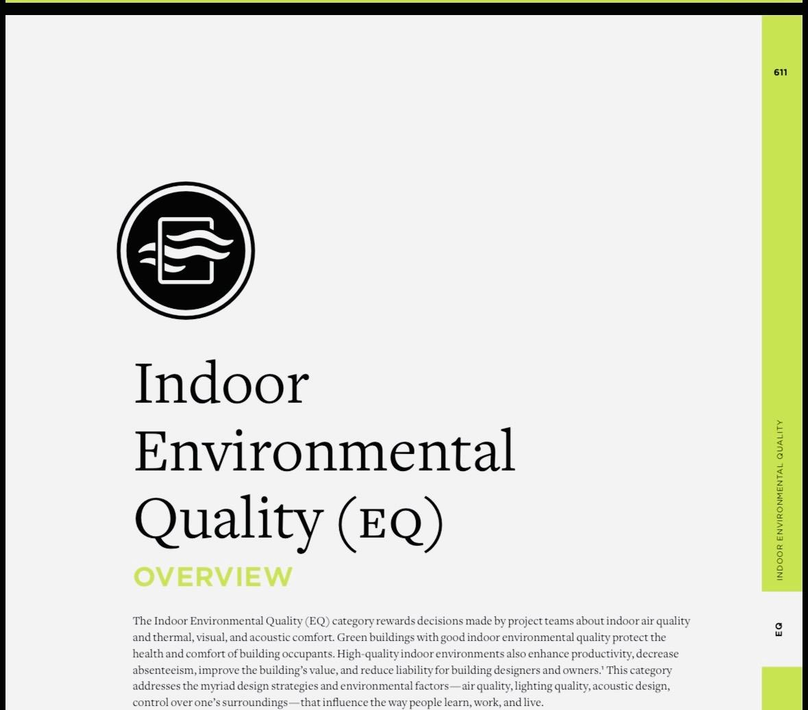
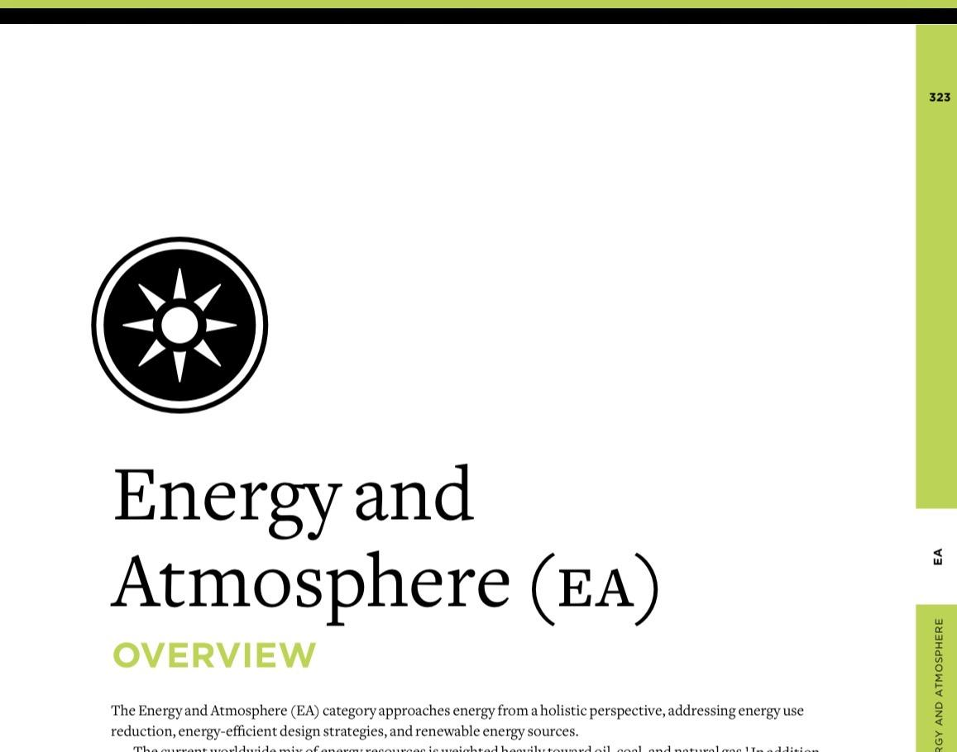
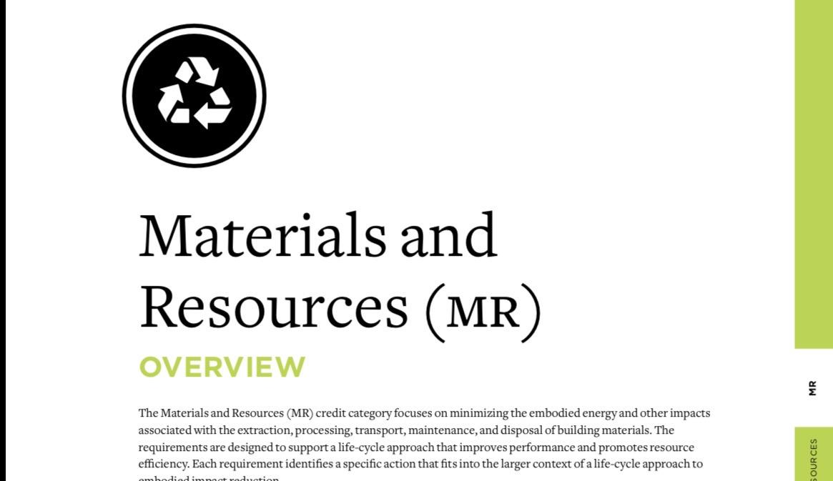
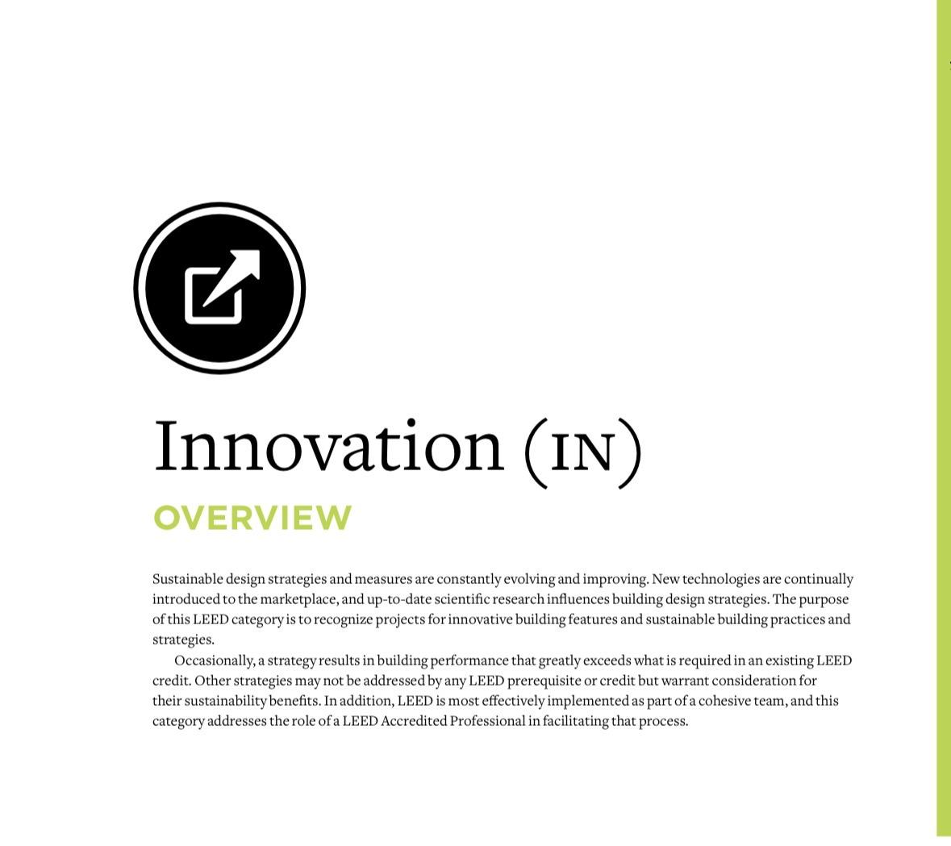
RRI’s Sustainable Insulation Product
Meets Criteria of Several
LEED US Green Building Council
Credit Categories!
Notes:
“Thank you for your time. Together, we can transform mattress waste into opportunity, building cleaner communities for future generations.”

Slide 13
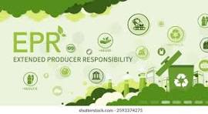
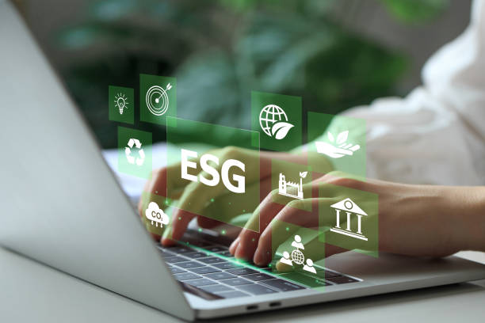



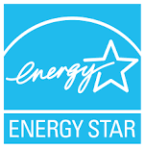


Local & State EPR Mandates for Recycle & Reuse
Large Companies Lead With Sustainability Models
Global & Federally Recognized Green Certifications
Drivers Toward Sustainable Practices
Notes:
Partnerships enable us to scale impact quickly. From city programs to corporate collaborations, our partners are essential in creating real change.”
RRI’s Diverse Partnerships Cover A Gamut of Diverse Industries.
Each Has A Common Goal: Handling Municipal Solid Waste and Finding Responsible Means of Handling & Disposal
Municipalities
Hotels
Waste Haulers/Transfer Stations
Building Owners/Property Management Companies: Public & Private
Design & Build: Architects, Demolition Teams, Building Developers
Mattress & Furniture Companies/Wholesale & Retail
Universities/Military Campuses

Slide 14
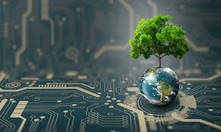
Capital Investment
In companies that are creating new
Recycling methods of operation & new Products made from recycled materials
Government Support
For Specification Testing Standards
Ie: Corrosive, Flame Insect Retardancy
Greenhouse Gases, PFAS
Utilizing Technology
AI to speed up automation: energy
Central App for Communities &
Companies to find local Recycle/Reuse
Centers
End Market Products
That repurpose 9% and more of recycled materials for a Circular Economy
Research Innovation & Best Practices
Notes:
Partnerships enable us to scale impact quickly. From city programs to corporate collaborations, our partners are essential in creating real change.”
RRI’s Diverse Partnerships Cover A Gamut of Diverse Industries.
Each Has A Common Goal: Handling Municipal Solid Waste and Finding Responsible Means of Handling & Disposal
Municipalities
Hotels
Waste Haulers/Transfer Stations
Building Owners/Property Management Companies: Public & Private
Design & Build: Architects, Demolition Teams, Building Developers
Mattress & Furniture Companies/Wholesale & Retail
Universities/Military Campuses

Slide 15
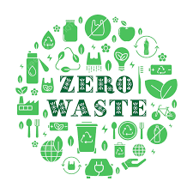
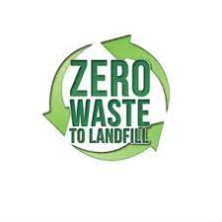
Policy Alignment:
Supporting Local & State Goals
RRI’S INITIATIVES TOWARD ZERO WASTE VISION:
  2024: RRI’s enhanced automated process increases recycling rate up to 95% and 3x volume increase
  2024-2025:
    R&D to enhance recycling process
    Significant investment for operations expansion
    Conceptual Design of End Product
    ELAP & Federal Certified Lab testing
    B.U.D. Submission to NYS DEC
  2026: End Market Product Commercialization
    RRI’s Begins Mass Manufacturing of Insulation Product
    Recycling & Manufacturing Process Expanded to Upstate NY & NJ
    Anticipated Volume Growth: 5x Current Capacity-=Job Creation
      Implementation of AI technology to measure landfill diversion tonnage through RRI’s custom app
Notes:
“RRI programs are designed to support local policy goals, helping leaders implement actionable solutions to reduce waste.”
RrI Team Performs Research & Investment To Expand It’s Recycling Process
RRI Concepts Insulation Product Made From 90% of Its Recycled Materials.
Rigorous Testing of It’s Processed Materials Through ELAP & Federal Certified Labs, Favorable Results Have Allowed RRI To Submit B.U.D. To NYS DEC.
Potential For Tens of Thousands OF Textile tonnage Diverted From Landfills Across NYS & US
2026:
Product Is Brought To Commercialization
RRI’s Begins Mass Manufacturing Of End Product
RRI Replicates Its Recycling & Manufacturing Process To Upstate NY
Anticipated Volume Growth: 5x Current Capacity
Job Creation

Slide 16
CHRISTINE KIOURTSIS - CEO/PRESIDENT
CHRISTINE@RENEWABLERECYCLING.COM
917 - 541 - 6971
https://www.renewablerecycling.com
Notes:
“Thank you for your time. Together, we can transform mattress waste into opportunity, building cleaner communities for future generations.”

