Slide 1

Recycling Meet 2026
New Life for Old Things:
Upcycling as a Retirement Strategy
March 16, 2026
Joao Batista Rosolem

Slide 2
Outline
Introduction.
Some data of upcycling.
Key benefits of upcycling in retirement.
Types and techniques of upcycling.
My technique.
Some results.
Final remarks.

Slide 3
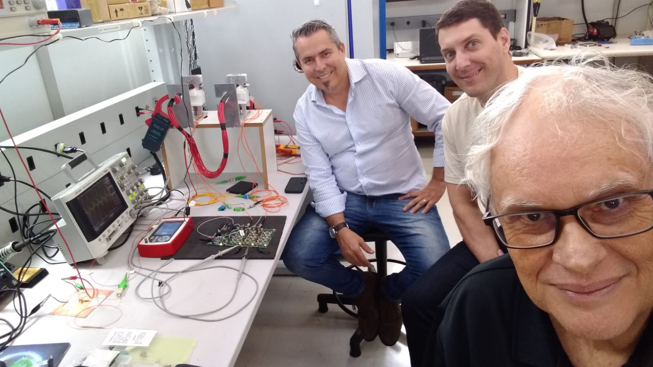
Introduction
I am a scientist, but not in the field of recycling.
My contribution to this event will be about creative reuse or upcycling mainly for retirement, as an artist.
As far as I know, this is the first approach to this subject in the International Virtual Recycling Conferences.

Slide 4
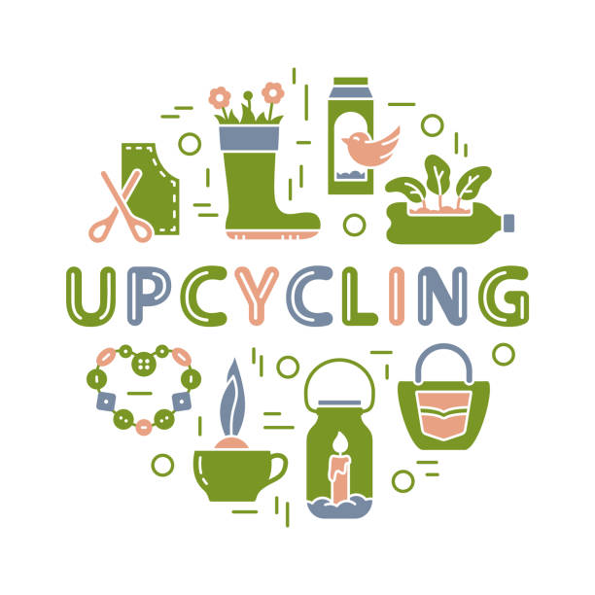
Some data of upcycling
Upcycling is the concept of transforming and reusing old or worn-out materials into new products.
While recycling entails undergoing a cycle of collection, processing, and transformation, upcycling uses old or obsolete objects and materials to create new products with a completely different purpose.
Designers worldwide use upcycling to produce beautiful handmade pieces, be it decoration or fashion, while also reducing waste.
You can find more information using internet search engine for decoration and in some CATV channels.

Slide 5
Types and techniques of upcycling
Fashion/textile upcycling:
  Involves transforming old garments into new clothes or accessories.
Furniture upcycling:
  Refurbishing or redesigning old furniture.
Creative/artistic reuse:
  Transforming waste materials into art or functional decor, such as creating lamps from old wine bottles or sculptures from metal scrap.
Structural repurposing:
  Utilizing industrial or building materials for new, different purposes, such as using pallets for furniture or turning old doors into table tops.
Food waste upcycling:
  Using food by-products to create new, edible, or useful products, such as turning brewery waste into animal feed or fruit peels into pectin.
C. Parung et al, Upcycling Design Process and Classification of Upcycling Method as Innovation to Extend Product Lifecycle, March 2022, DOI:10.46254/AN12.20220022

Slide 6

Key benefits of upcycling in retirement
Cognitive health and mental stimulation:
  Keeps the mind active, creative expression, sense of accomplishment.
Physical and social engagement:
  Active hobby, social connections, skill development.
Financial and economic advantages:
  Saves money, potential income source, low-cost materials.
Environmental and sustainable impact
  Reduces landfill waste, conserves resources, lowers carbon footprint.
Personalized living spaces
  Unique home décor, functional revival.
J. Singhet al, Challenges and opportunities for scaling up upcycling businesses – The case of textile and wood upcycling businesses in the UK, November 2019, DOI: 10.1016/j.resconrec.2019.104439

Slide 7
My technique
I approach upcycling activities as a technological project, just as I do in my work as a scientist.
My preference is for the creative reuse of cast iron technological objects from the first half of the 20th century.
The materials used for recycling are the cast iron objects, stained glass varnish, epoxy resin, masking tape and cleaning materials.
Cast iron objects are commonly found in antique shops and scrap yards.

Slide 8
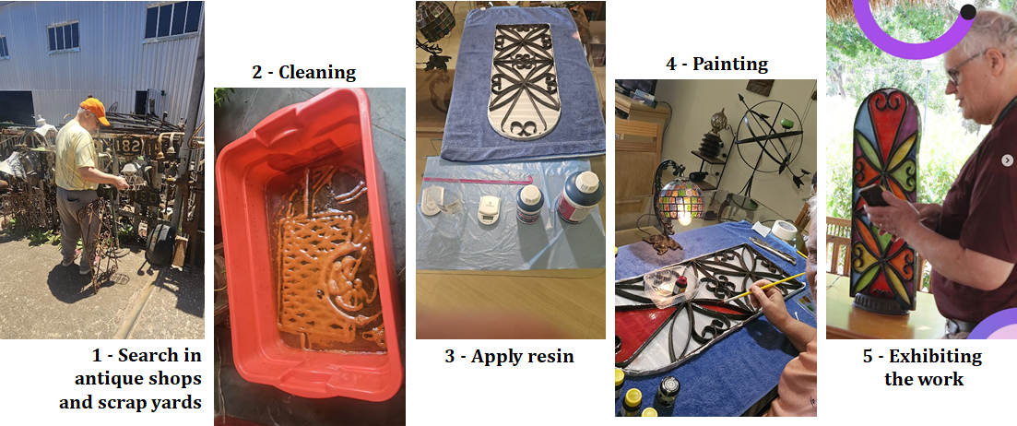
Upcycling steps

Slide 9
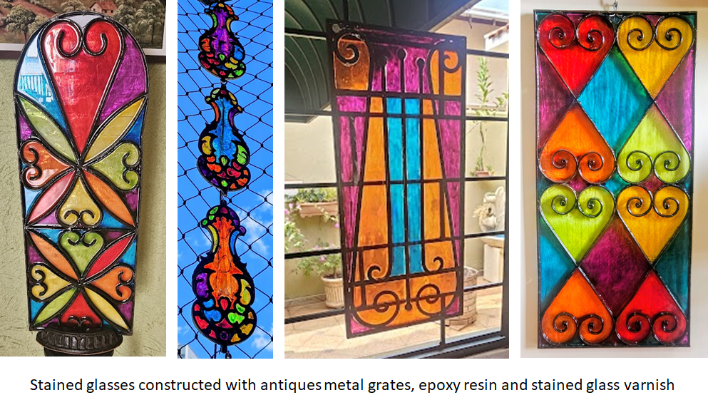
Some results: creating stained glasses

Slide 10
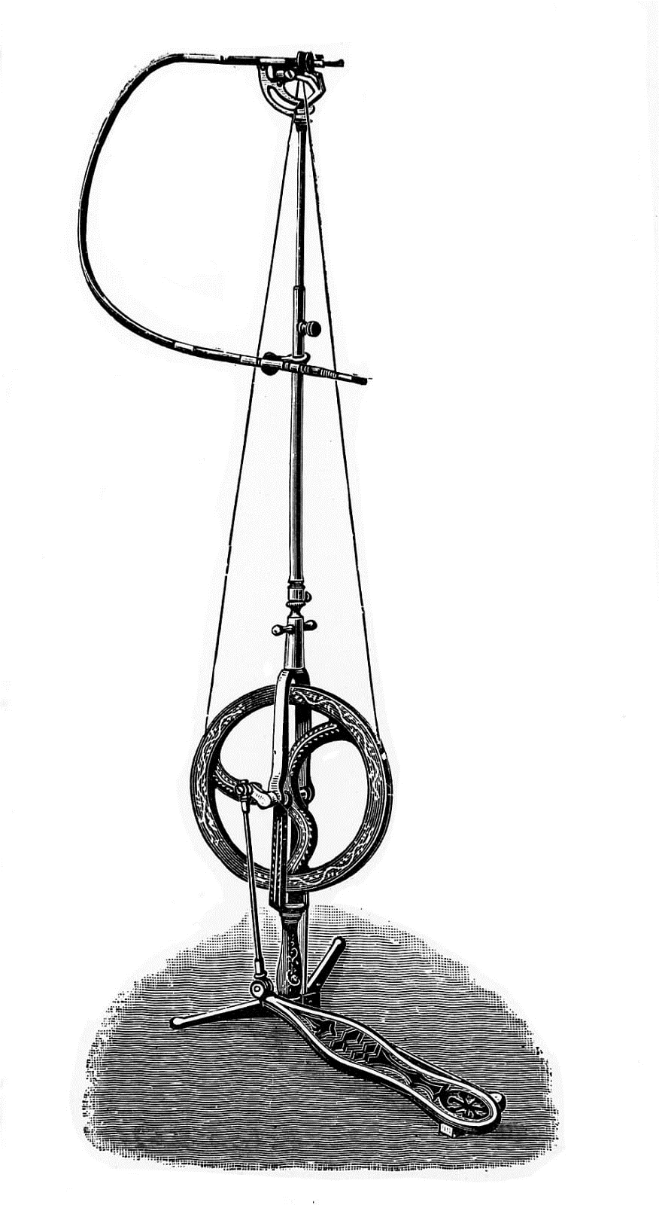
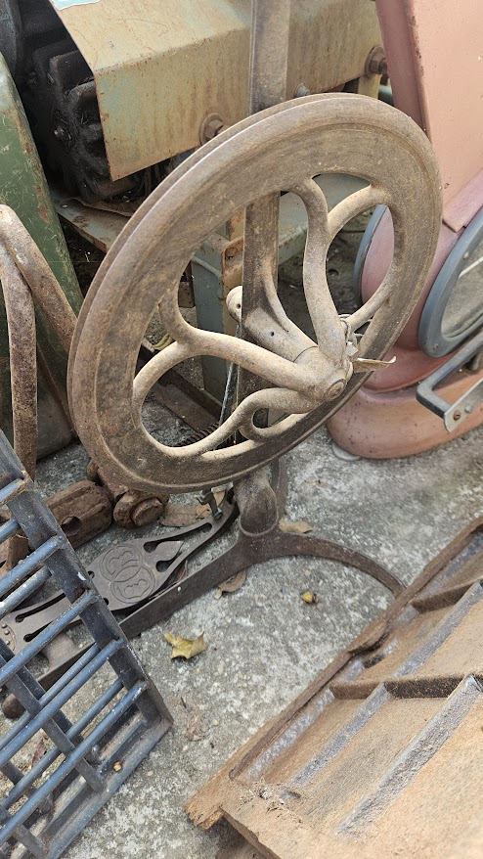
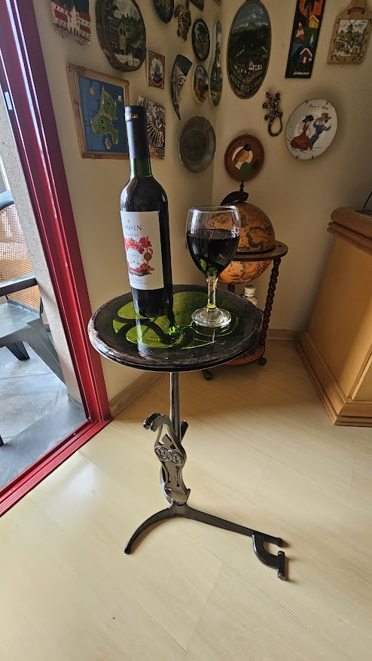
Some results: transforming old technological objects
Pedal driven dental drill
In the scrap yards
Upcycled (bar table)

Slide 11
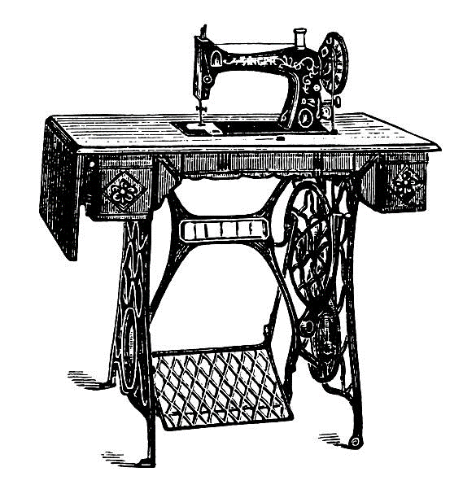
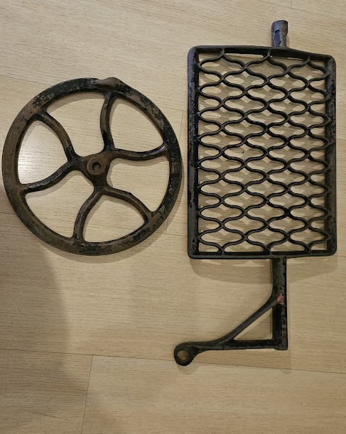
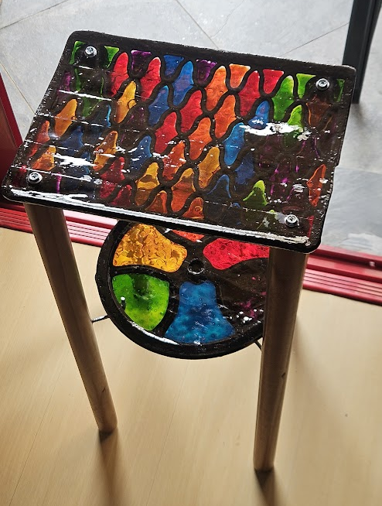
Some results: transforming old technological objects
Sewing machine
Rescued from the scrap yards
Upcycled (side table)

Slide 12
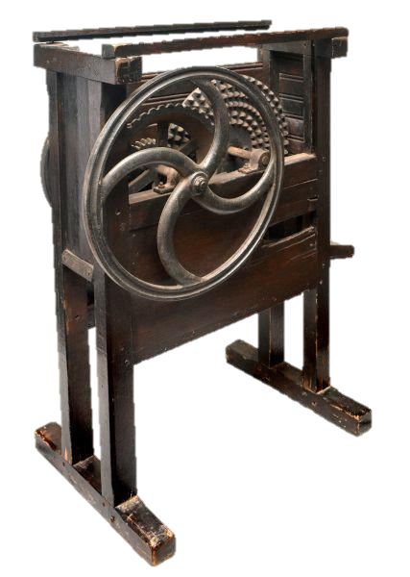
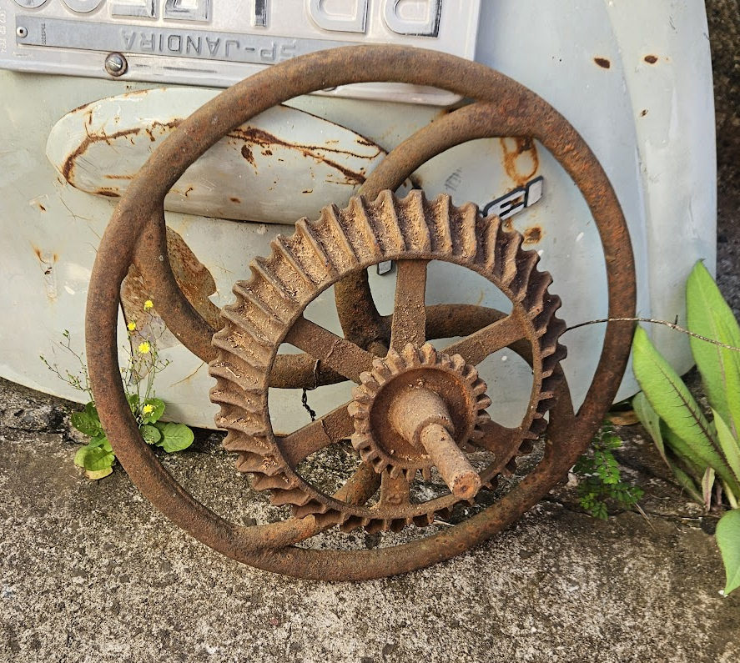
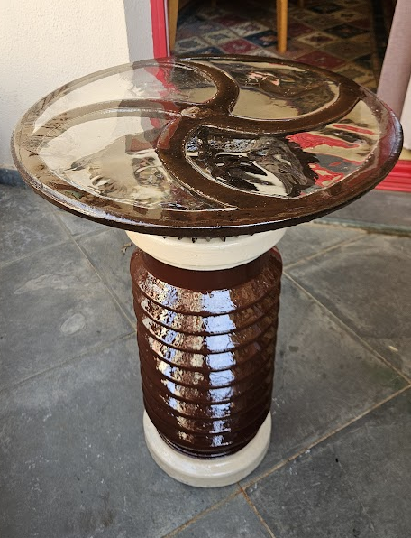
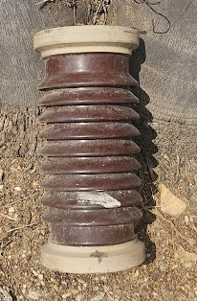
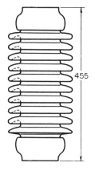
Some results: transforming old technological objects
In the scrap yards
Corn sheller
Electrical
insulator
Upcycled (garden table)

Slide 13
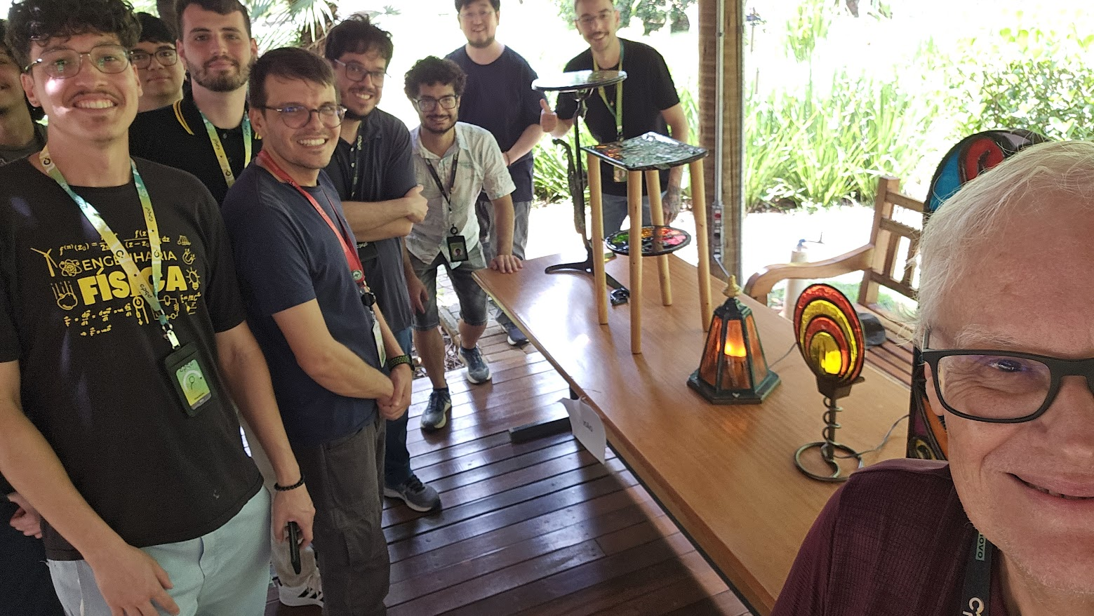
Some results: exhibition at my company
The "Taking Care of Myself" Program from CPQD emphasizes the practice of daily mental health.

Slide 14
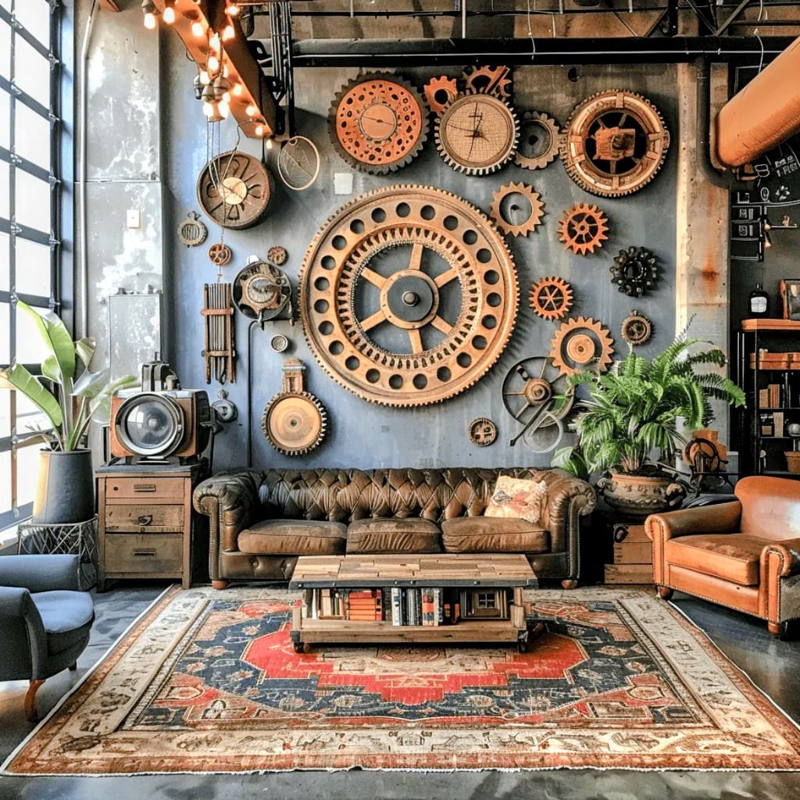
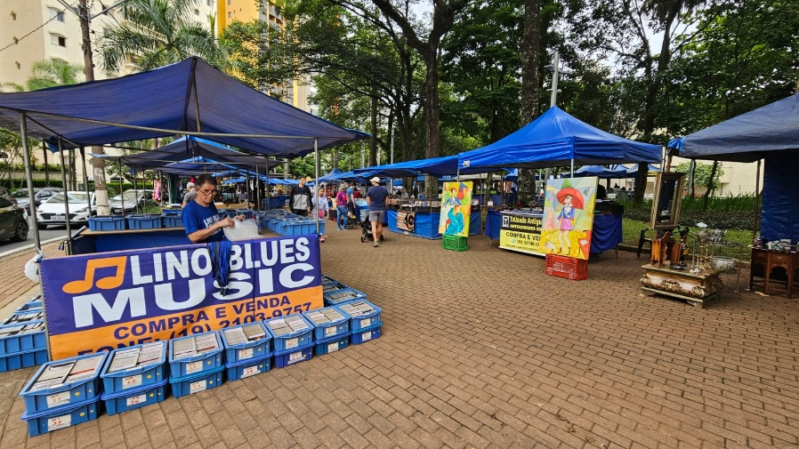
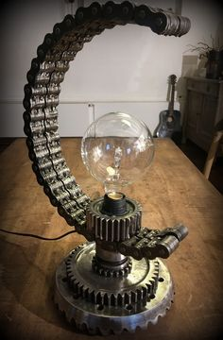
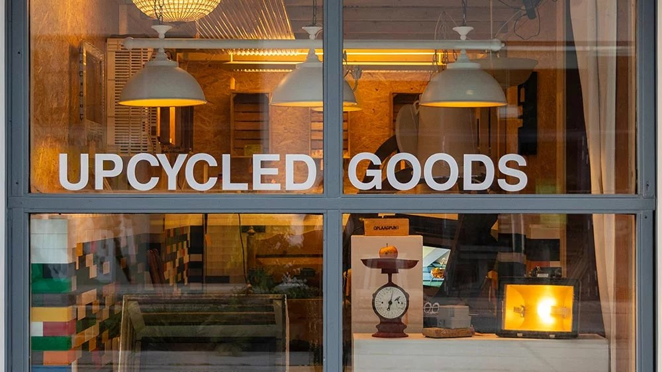

Final remarks
The practice of recycling has definitely brought me cognitive and social stimulation.
Some questions remain unanswered:
  Could the toxicity of materials used in creative recycling cause me health problems?
  How and where should I properly dispose of leftover recyclable materials?
  What is the final destination of the upcycled items?
Home decoration
Craft fairs

Slide 15
International Virtual Recycling 2026
Thank you!
Joao Batista Rosolem
jbrosolem@gmail.com

